Slide 1
Standard slides for Business Central analytics sessions
Copy-paste-edit at your own will

Slide 2









Typical analytics needs in organizations
Typical ways to consume data
KPIs
Dashboards
Financial reports
Data aggregation
Performance data
Leadership
Trends, summaries
Organizarional hierachy
Management
Managerial reports
Ad-hoc analysis
Detailed
data
Staff
Operational reports
On-screen task data
Notes:
This slice shows where Power BI, Data Analysis, and Excel fit into the analytics story

Slide 3
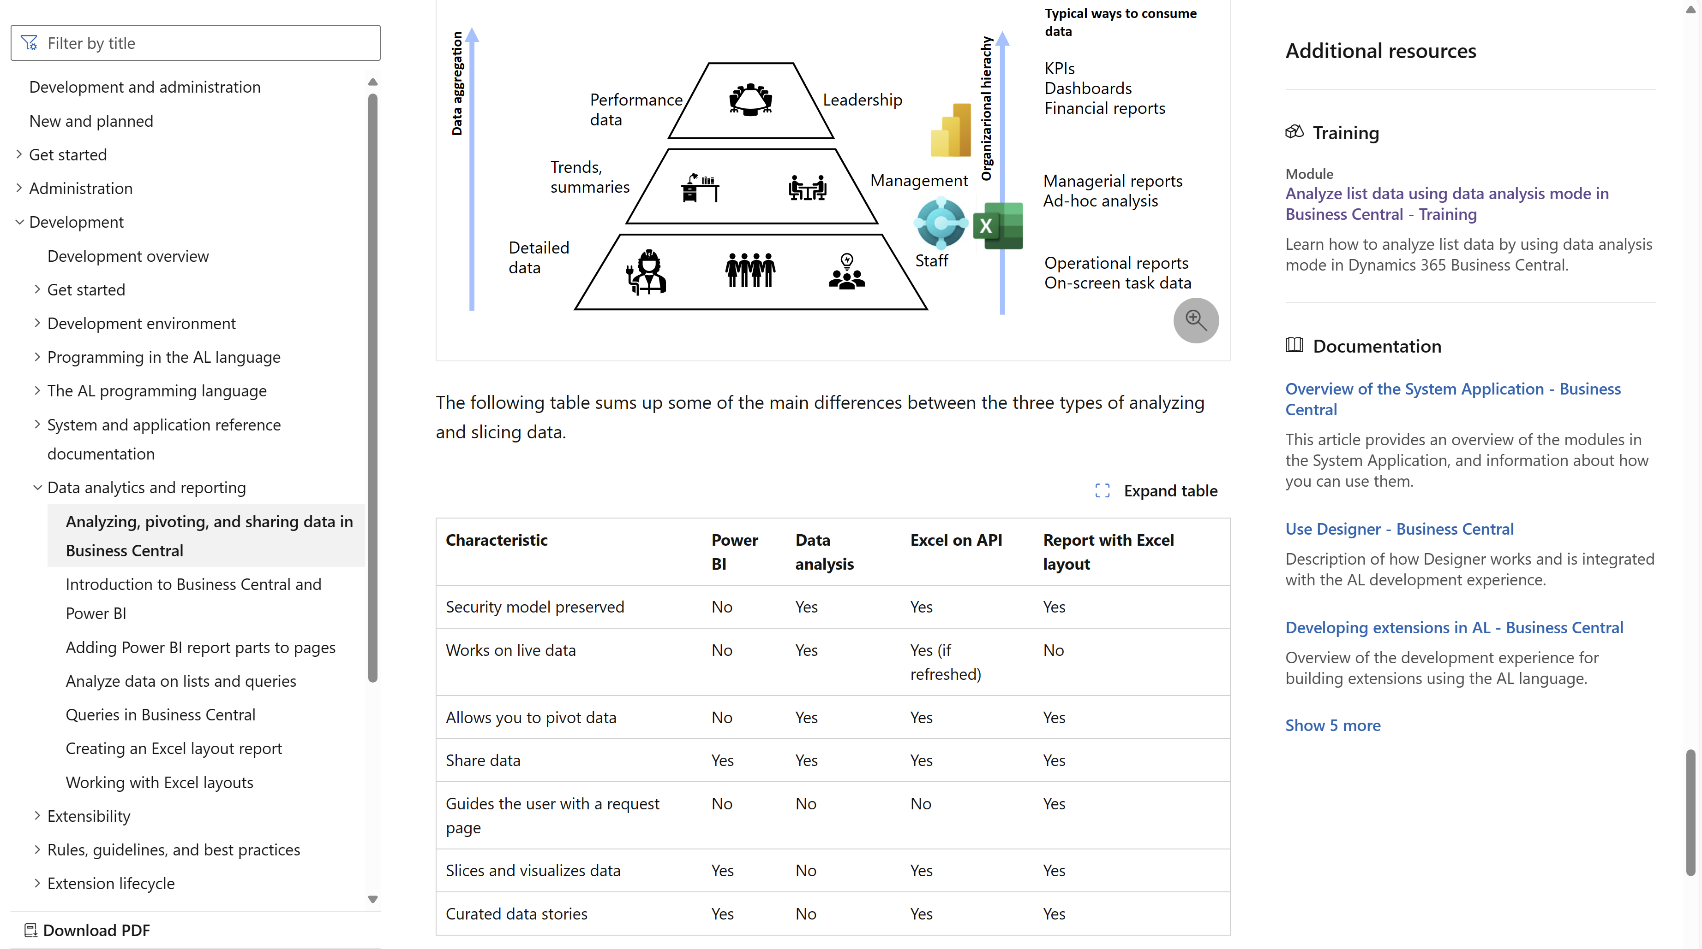
Developer docs https://aka.ms/bcDeveloper
Notes:
This is the developer docs that explains the BI triangle., how tools map to user needs, and different characteristics of the tools.

Slide 4


Analytics content and choice of technology
Security model preserved
Live data
Pivot data
Share the data
Security model preserved
Live data
Guide the user with a request page
Share the data
Pivot data
Slicers + visuals
New security model
Refresh needed (for now)
Curated data stories
Slices, KPIs, visuals
Not for pivoting data
Share the data
Notes:
This overview shows some properties of each cabability

Slide 5
The world is changing (in reporting)
If customer asks, “Can you build me a report?”
STOP asking “Sure. How should it be formatted?”
INSTEAD ask “What do you need to analyze and for what?”
THEN choose the tool of choice
Power BI (and embed), or
Query/List page with Data Analysis, or
AL report with Excel layout
Notes:
You might end a session for developers with this (recapping the BI triangle)

Slide 6
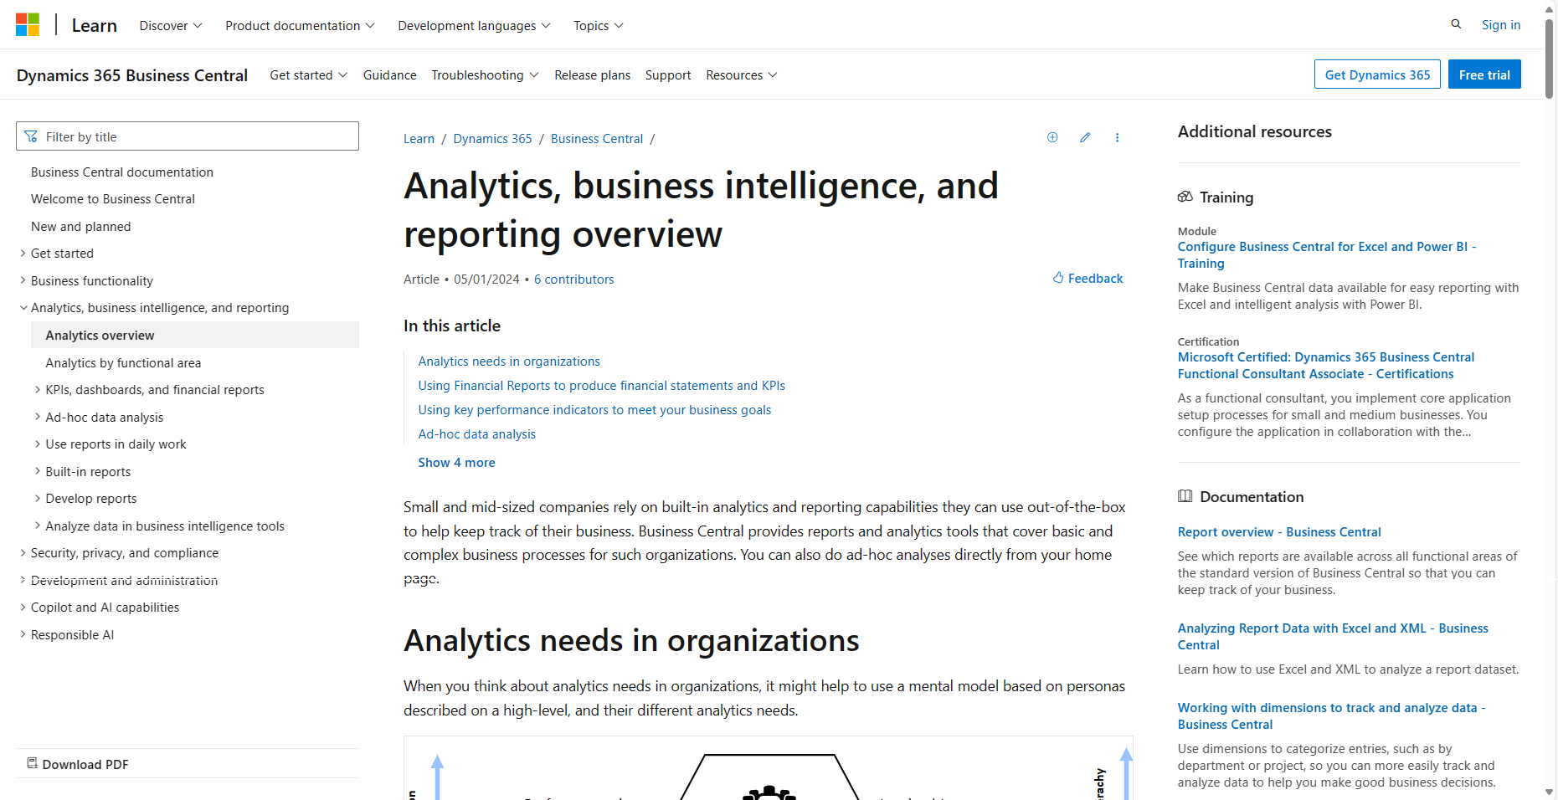
aka.ms/bcAnalytics (for users)
Notes:
This is the general analytics story end-to-end

Slide 7
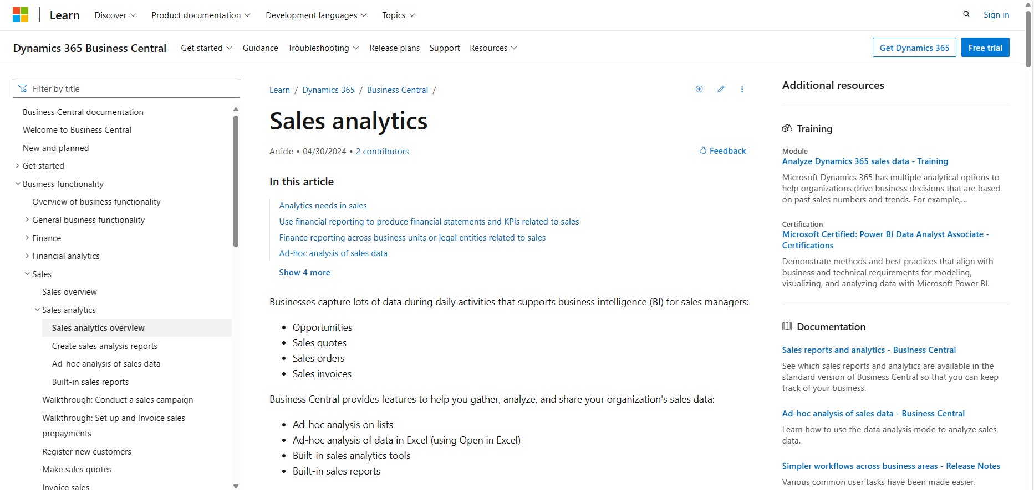
Analytics per functional area (finance, sales, purchase, inventory, …)
Notes:
This is the analytics story end-to-end for each functional area

Slide 8
Analytics aka links per functional area
aka.ms/bcFinanceAnalytics
aka.ms/bcSalesAnalytics
aka.ms/bcPurchasingAnalytics
aka.ms/bcFixedAssetsAnalytics
aka.ms/bcProjectAnalytics
aka.ms/bcInventoryAnalytics
aka.ms/bcManufacturingAnalytics

Slide 9
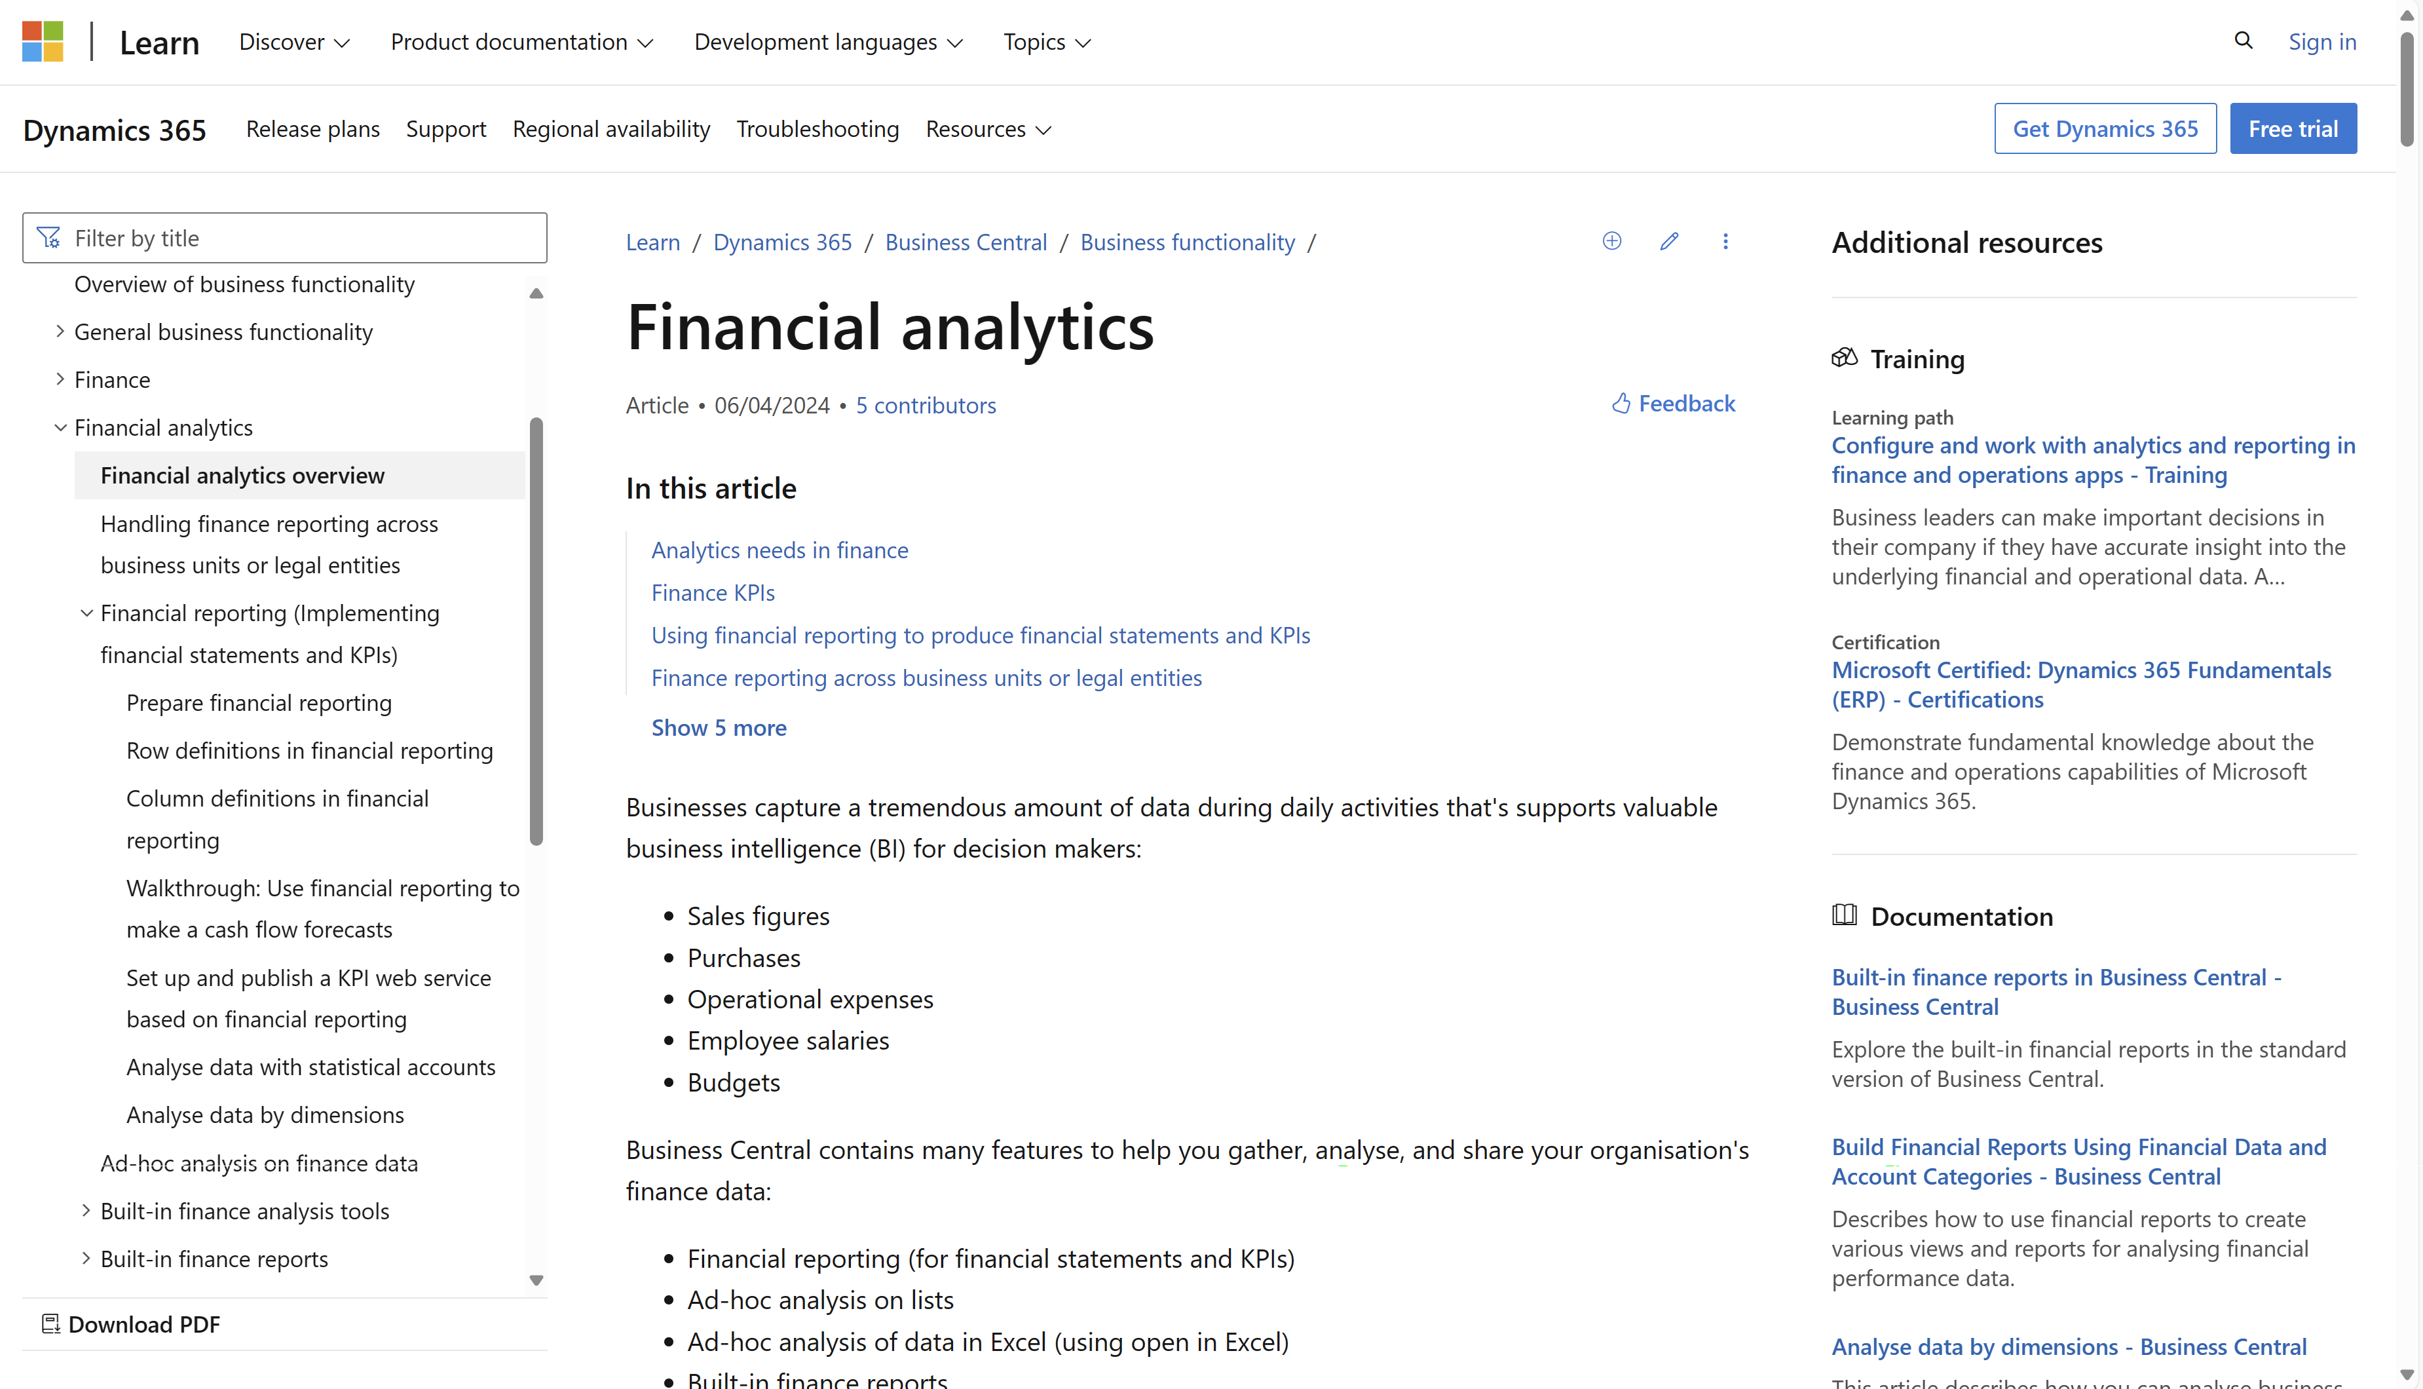
Example: Financial Analytics
Notes:
This is the analytics story end-to-end for each functional area

Slide 10
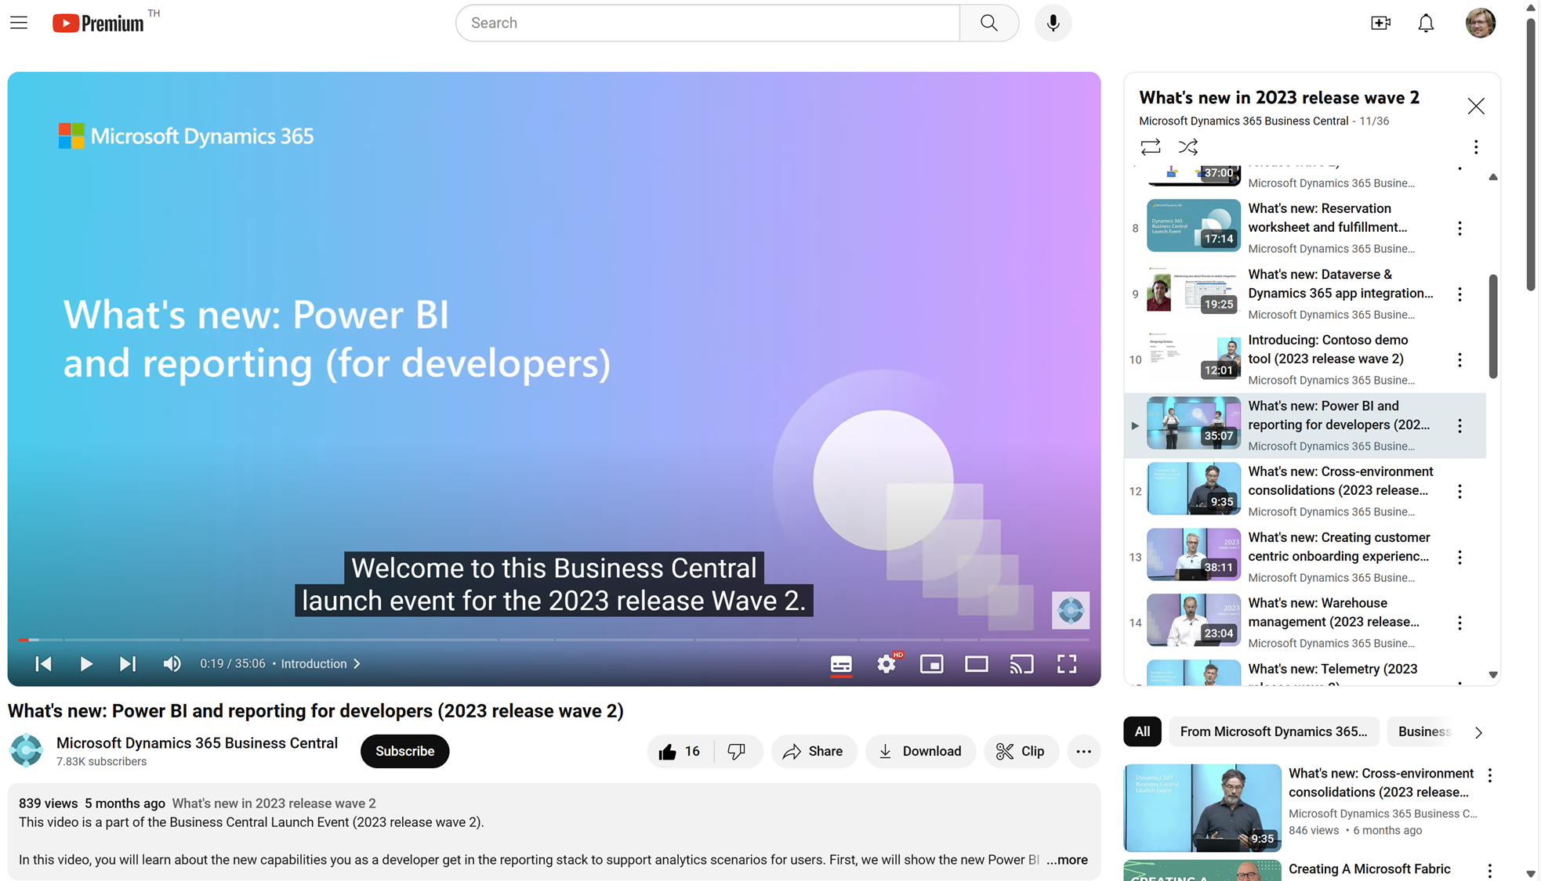
Watch the video to learn more…
Notes:
This video explains the BI triangle for developers

Slide 11
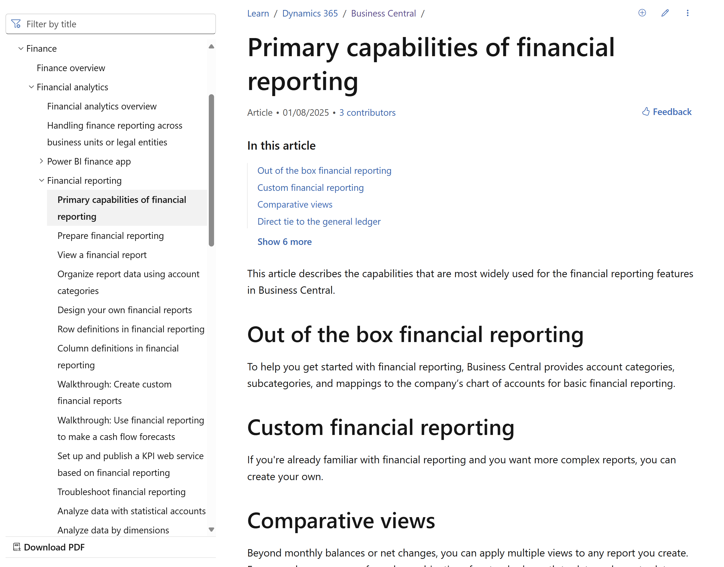
Financial Reporting documentation aka.ms/bcFinanceAnalytics

Slide 12
Financial Reporting changes in 26.0 – part 1
Financial report viewers can:
Choose to hide empty rows when they view a financial report.
Chose to print a financial report in portrait mode.
Choose to use an accounting format where negative numbers are formatted with () instead of a minus sign when running a financial report.
Release plan: Use enhanced Financial Reporting capabilities

Slide 13
Financial Reporting changes in 26.0 – part 2
Financial report owners can:
Document the use of report definitions (using an internal description field).
Write introduction and closing paragraphs for their reports.
Save their Excel templates in Business Central.
Run a financial report using a saved Excel template.
Use a new Month to Date column type.
Find financial reports that use a column or row definition.
Use an accounting format where negative numbers are formatted with () instead of a minus sign.
Open financial reporting when they create a new G/L account.

Slide 14
Financial Reporting changes in 26.0 – part 3
Administrators can:
Use the documentation to find out which permissions are needed to run or edit financial reports.
Use the documentation to find out how to set up auditing changes to report definitions.
Get telemetry on the use of financial reports and lifecycle events.
Track changes to financial reports in Microsoft Purview.

Slide 15
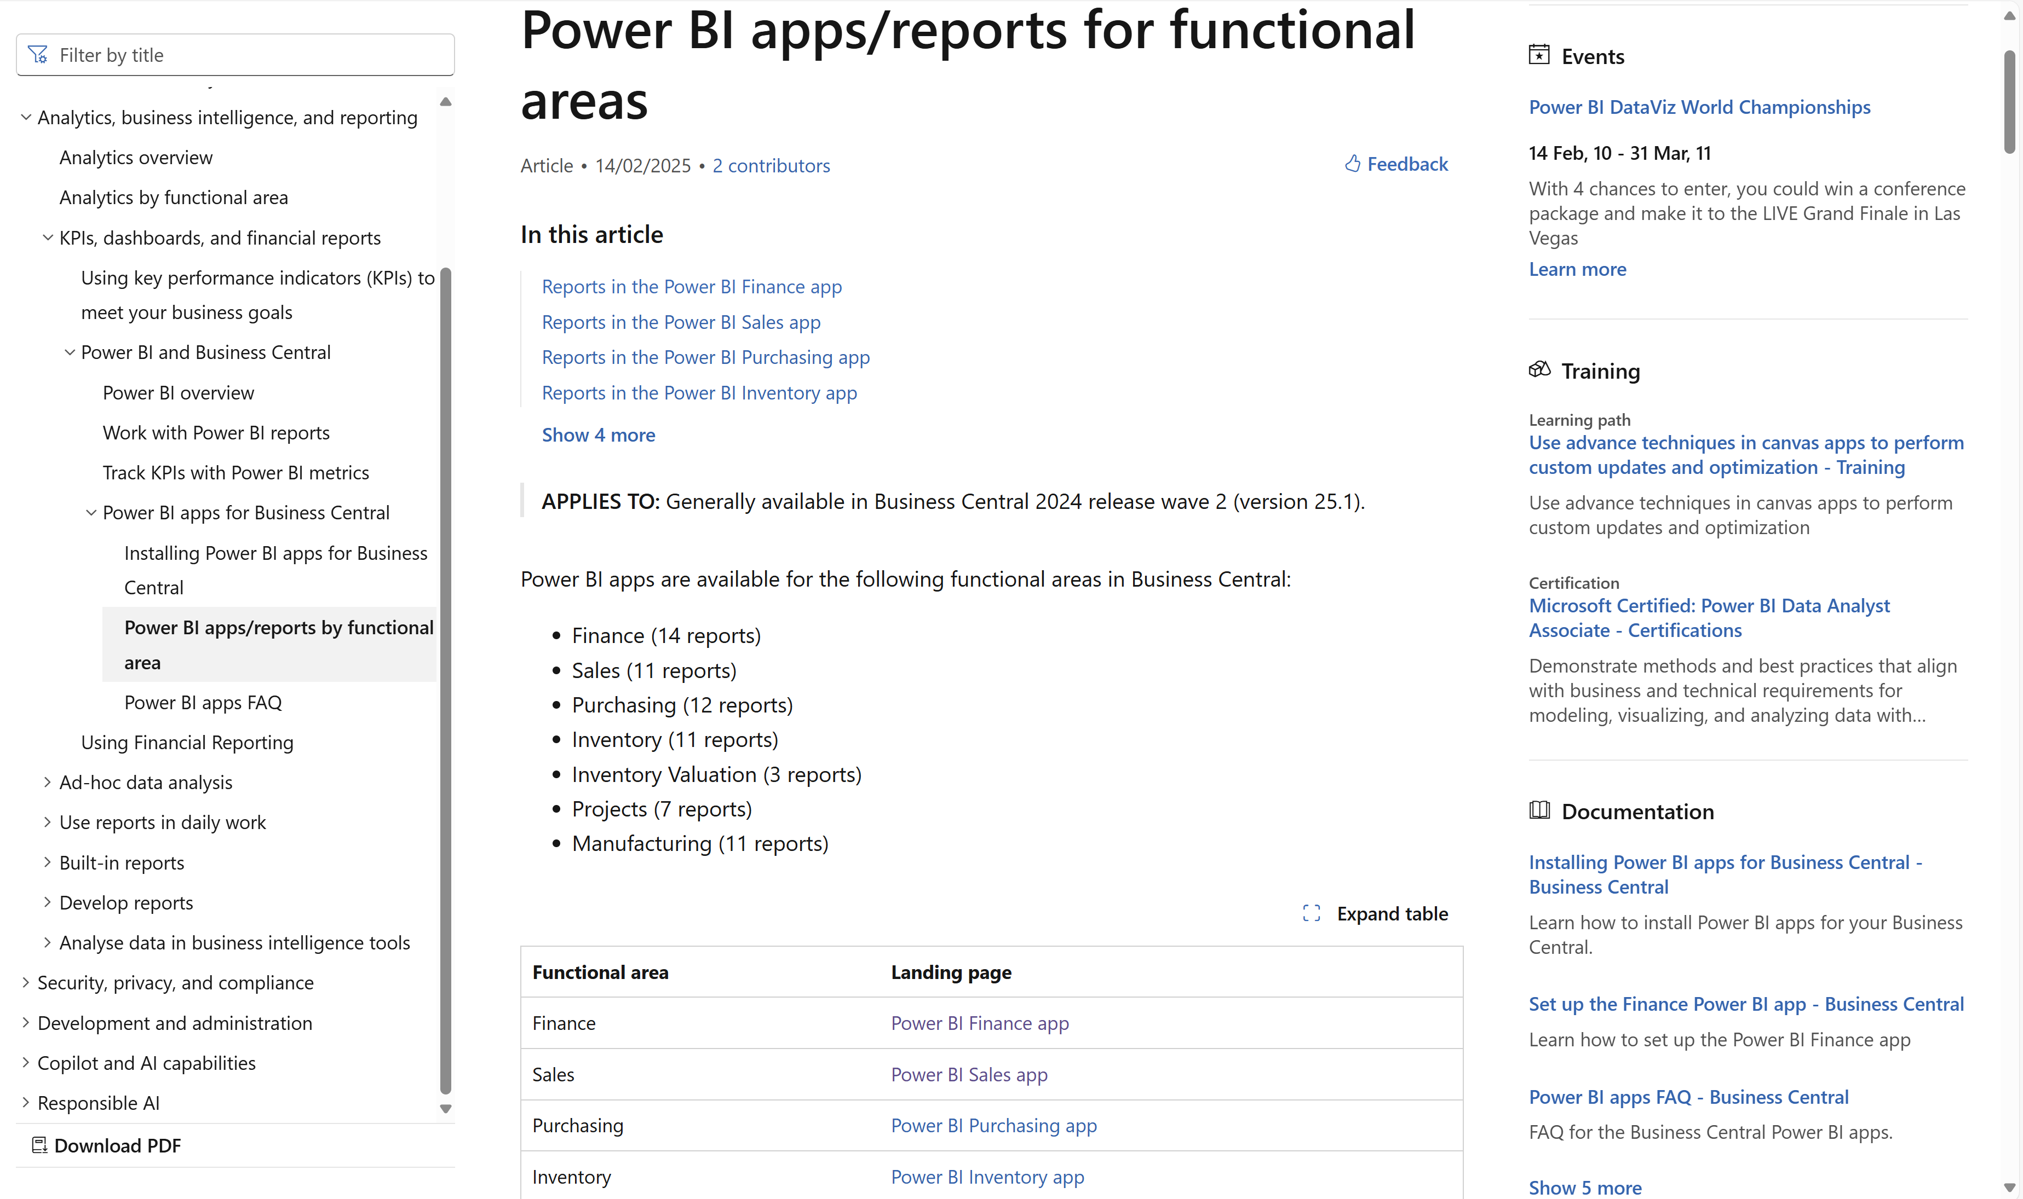
Notes:
Introduced in 25.1
Go to aka.ms/bcAnalytics and then navigate down to table of content

Slide 16
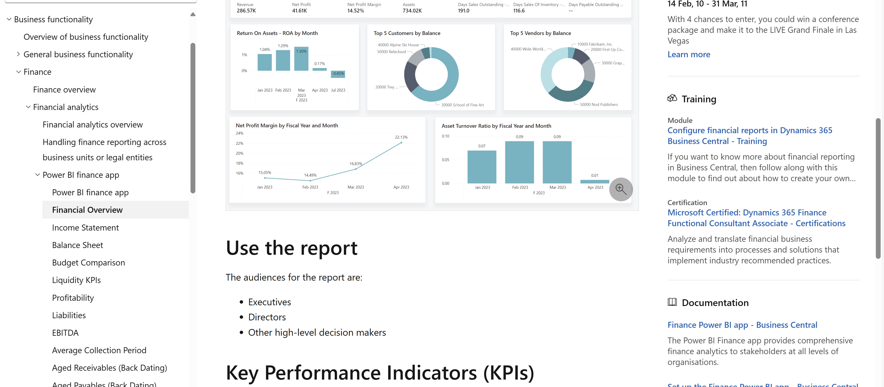
Each app is documented under its functional domain
Notes:
Each app is documented under its functional domain (use the aka links to navigate there)
Each report is documented with screenshots, usage scenarios, …
Each KPI is documented

Slide 17
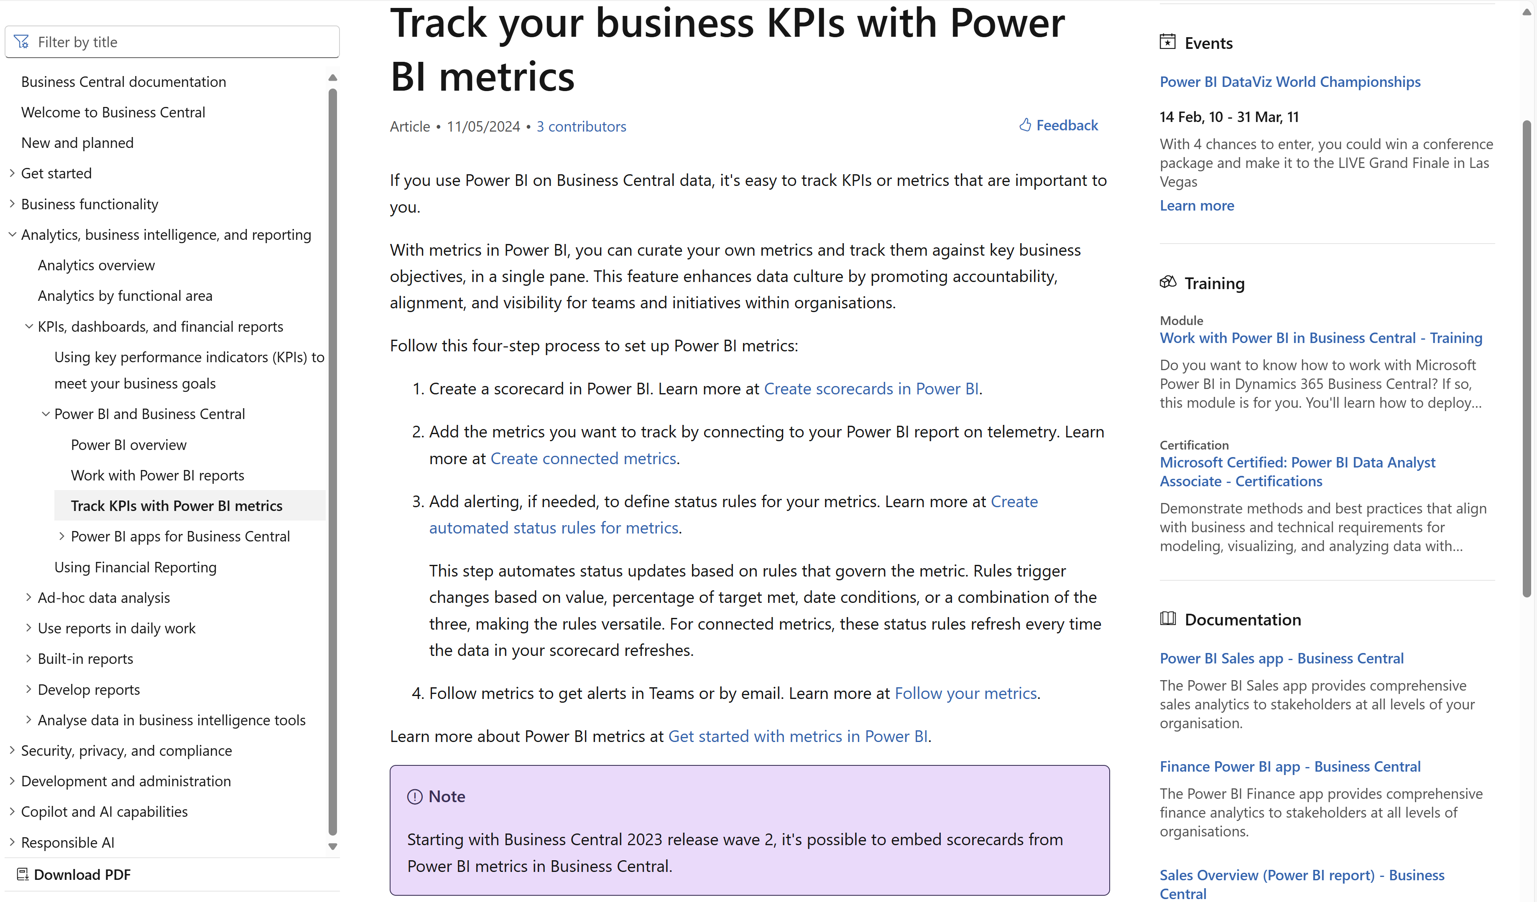
Notes:
Power BI metrics is included in Power BI pro license.

Slide 18
Power BI embed (for developers)
Notes:
Power BI embed (for developers)

Slide 19
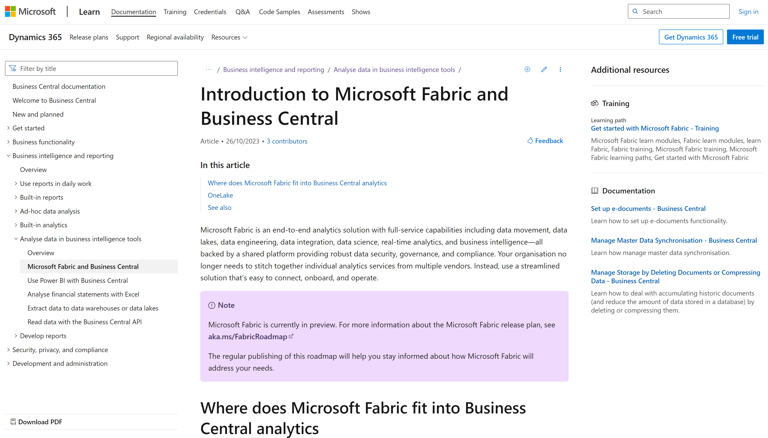
Notes:
If anyone asks about BC and Fabric

Slide 20
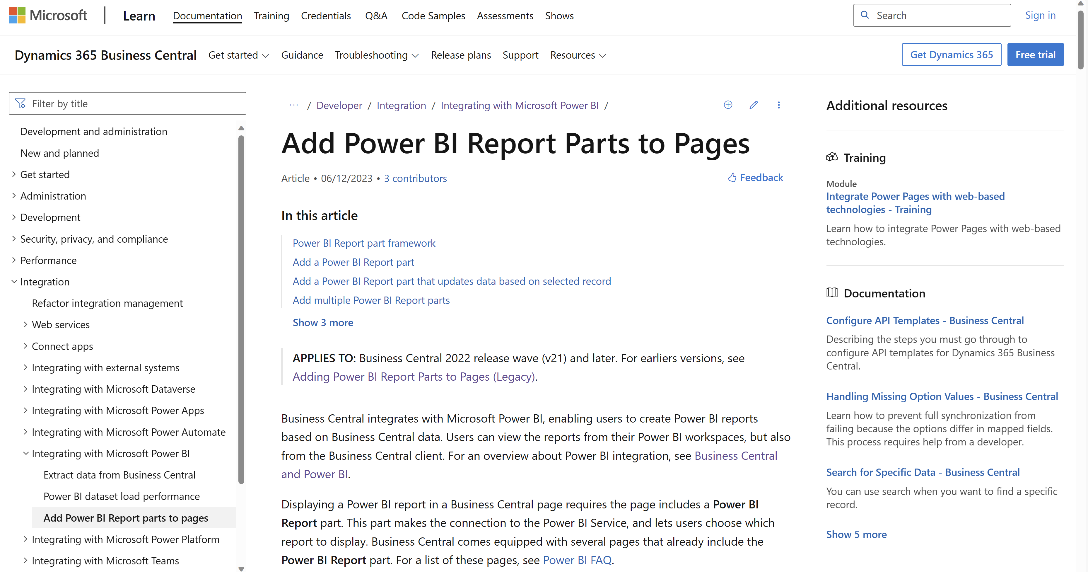
Notes:
Developer docs on how to embed Power BI on AL pages

Slide 21
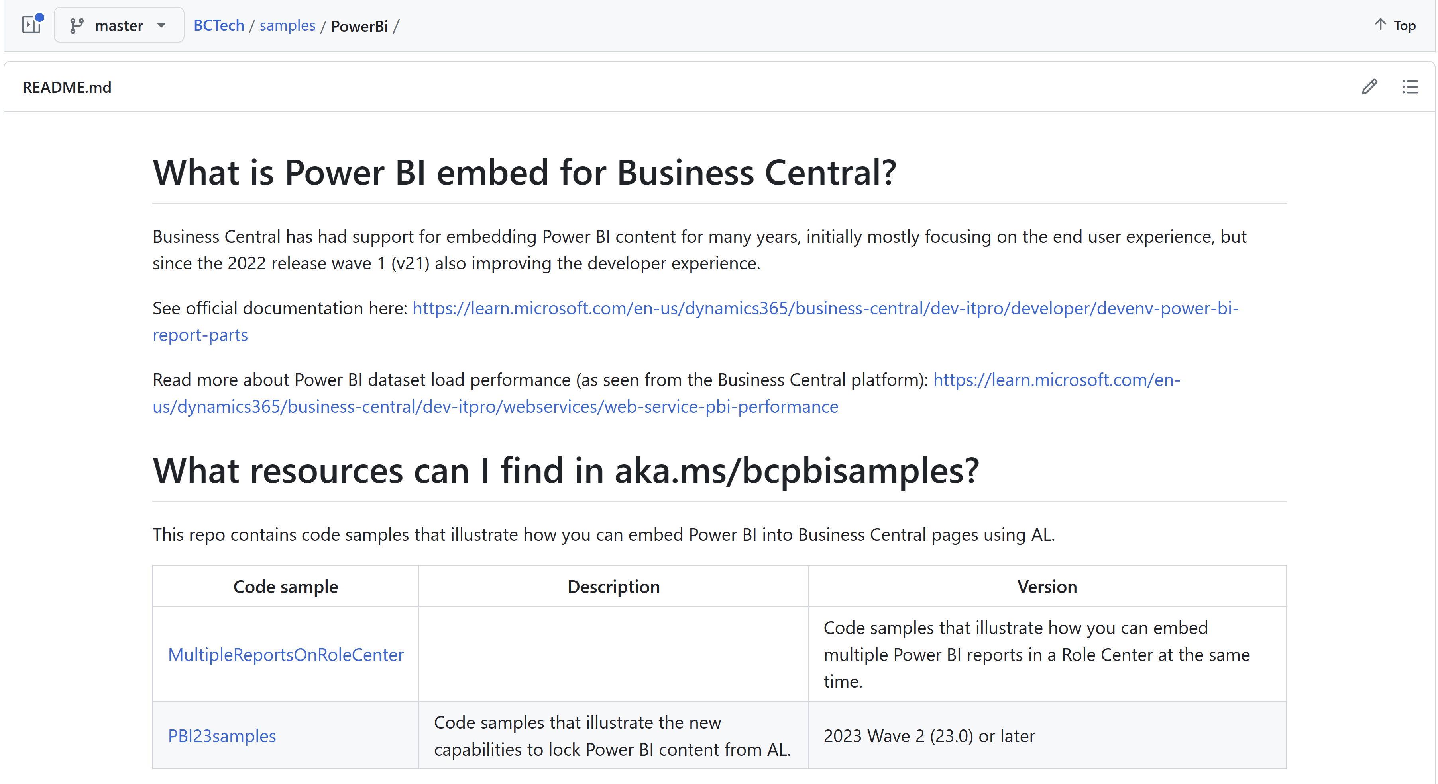
aka.ms/bcpbisamples
AL code samples for the new PBI embed capabilities in 2023w2
Notes:
Sample code on how to embed Power BI on AL pages

Slide 22
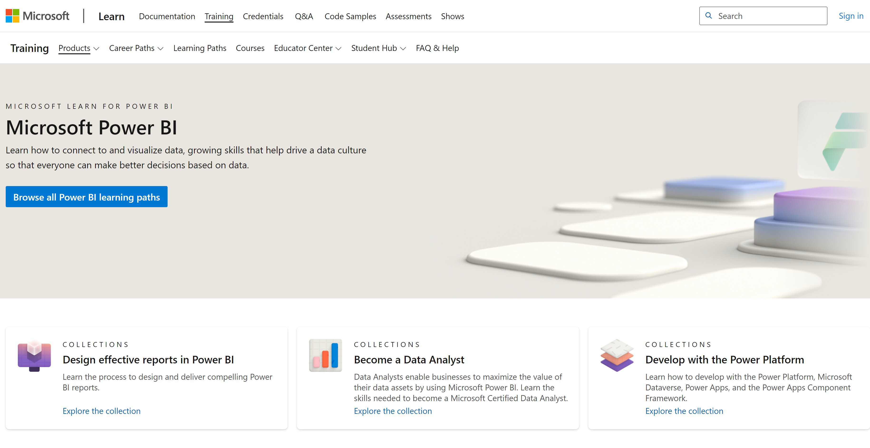
Notes:
PBI training

Slide 23
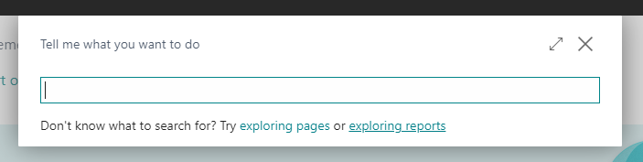
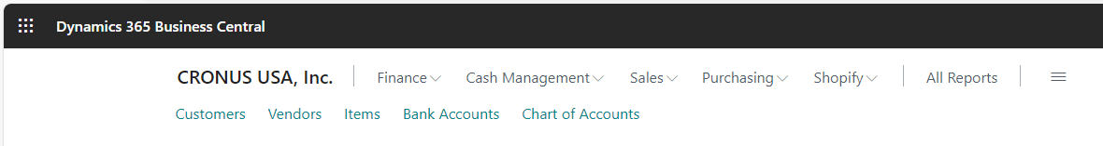
Links introduced in version 25.0

Slide 24
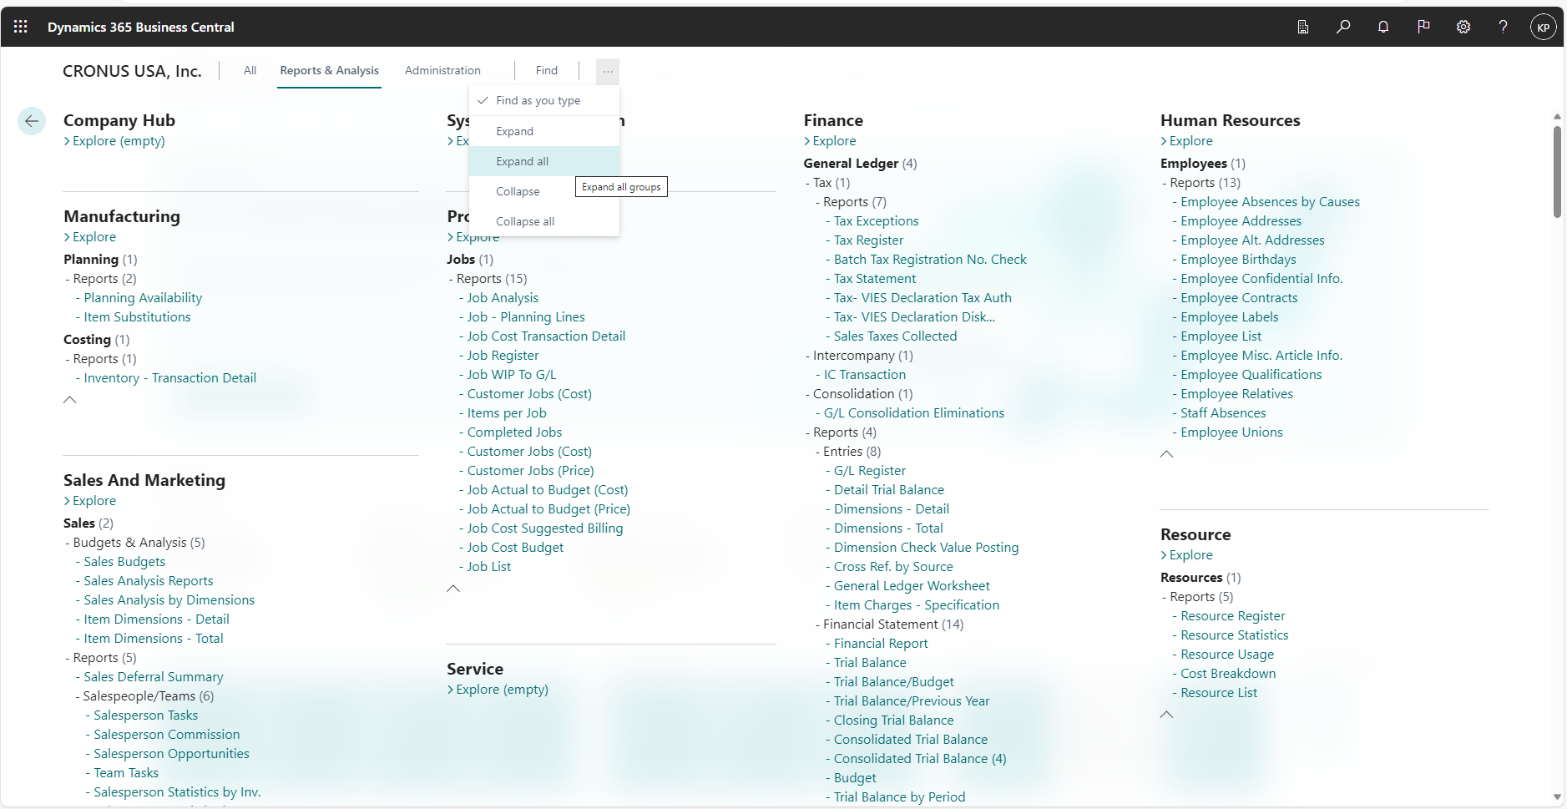
Report Explorer – shows all analytical capabilities
Notes:
If people ask if BC has any reports…

Slide 25
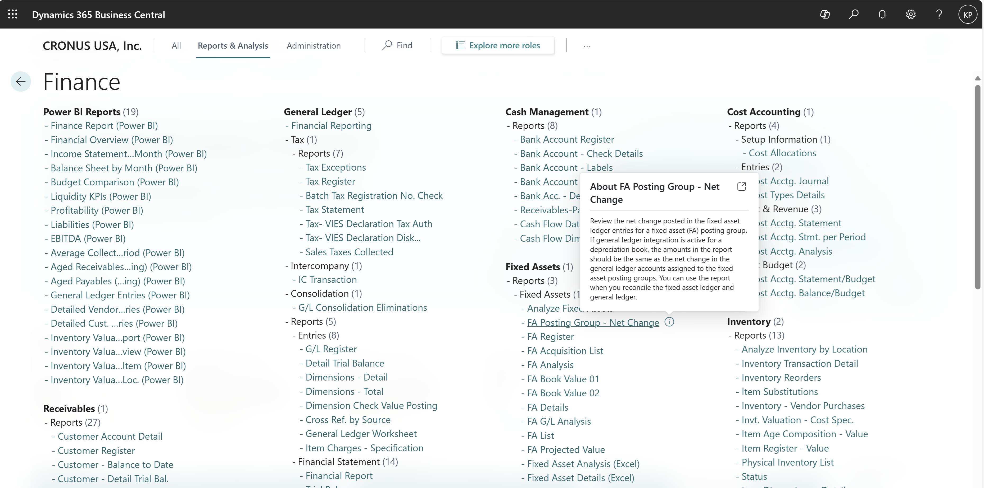
Report Explorer in 26.0 – now with info icons
Notes:
If people ask if BC has any reports…

Slide 26
Report Explorer in 26.0 – try a report in a new window
Notes:
If people ask if BC has any reports…

Slide 27
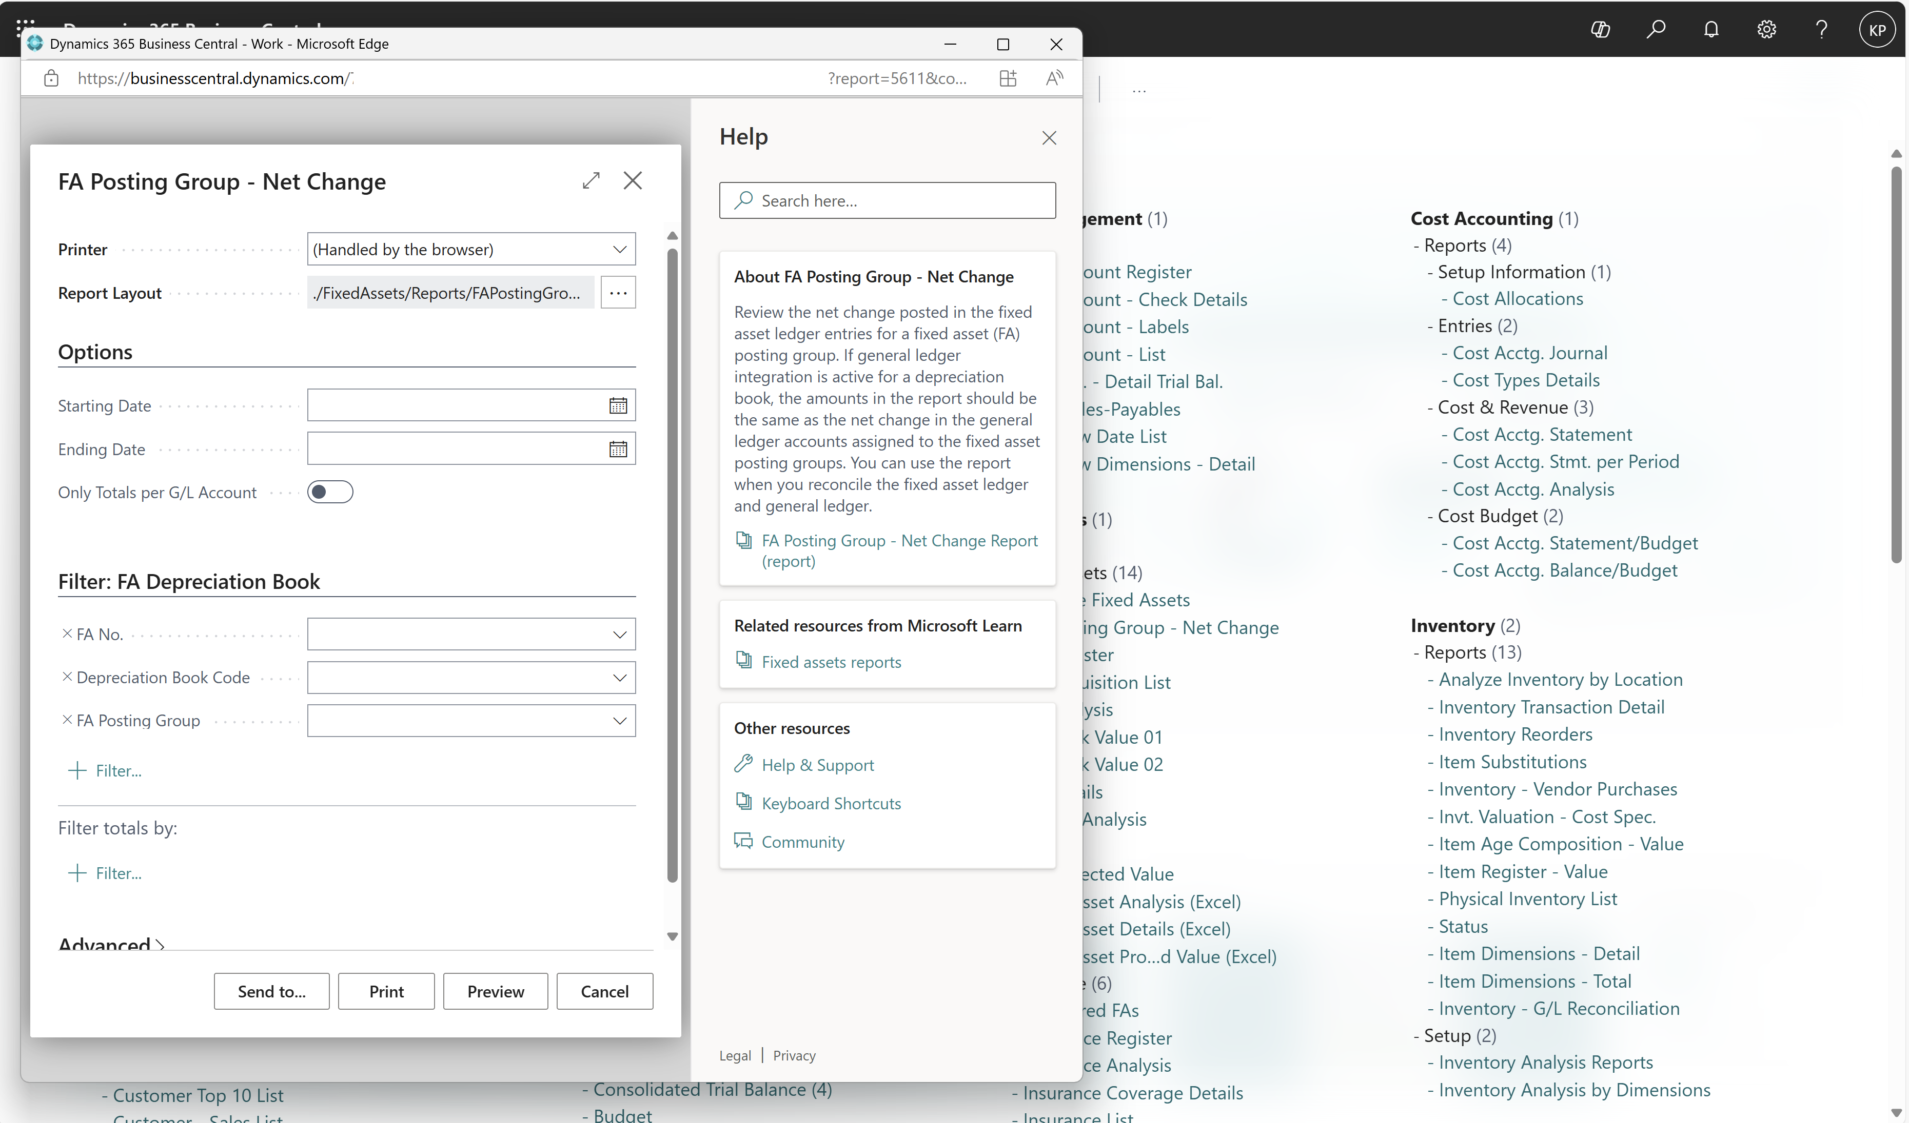
Opens report request page in a new window

Slide 28
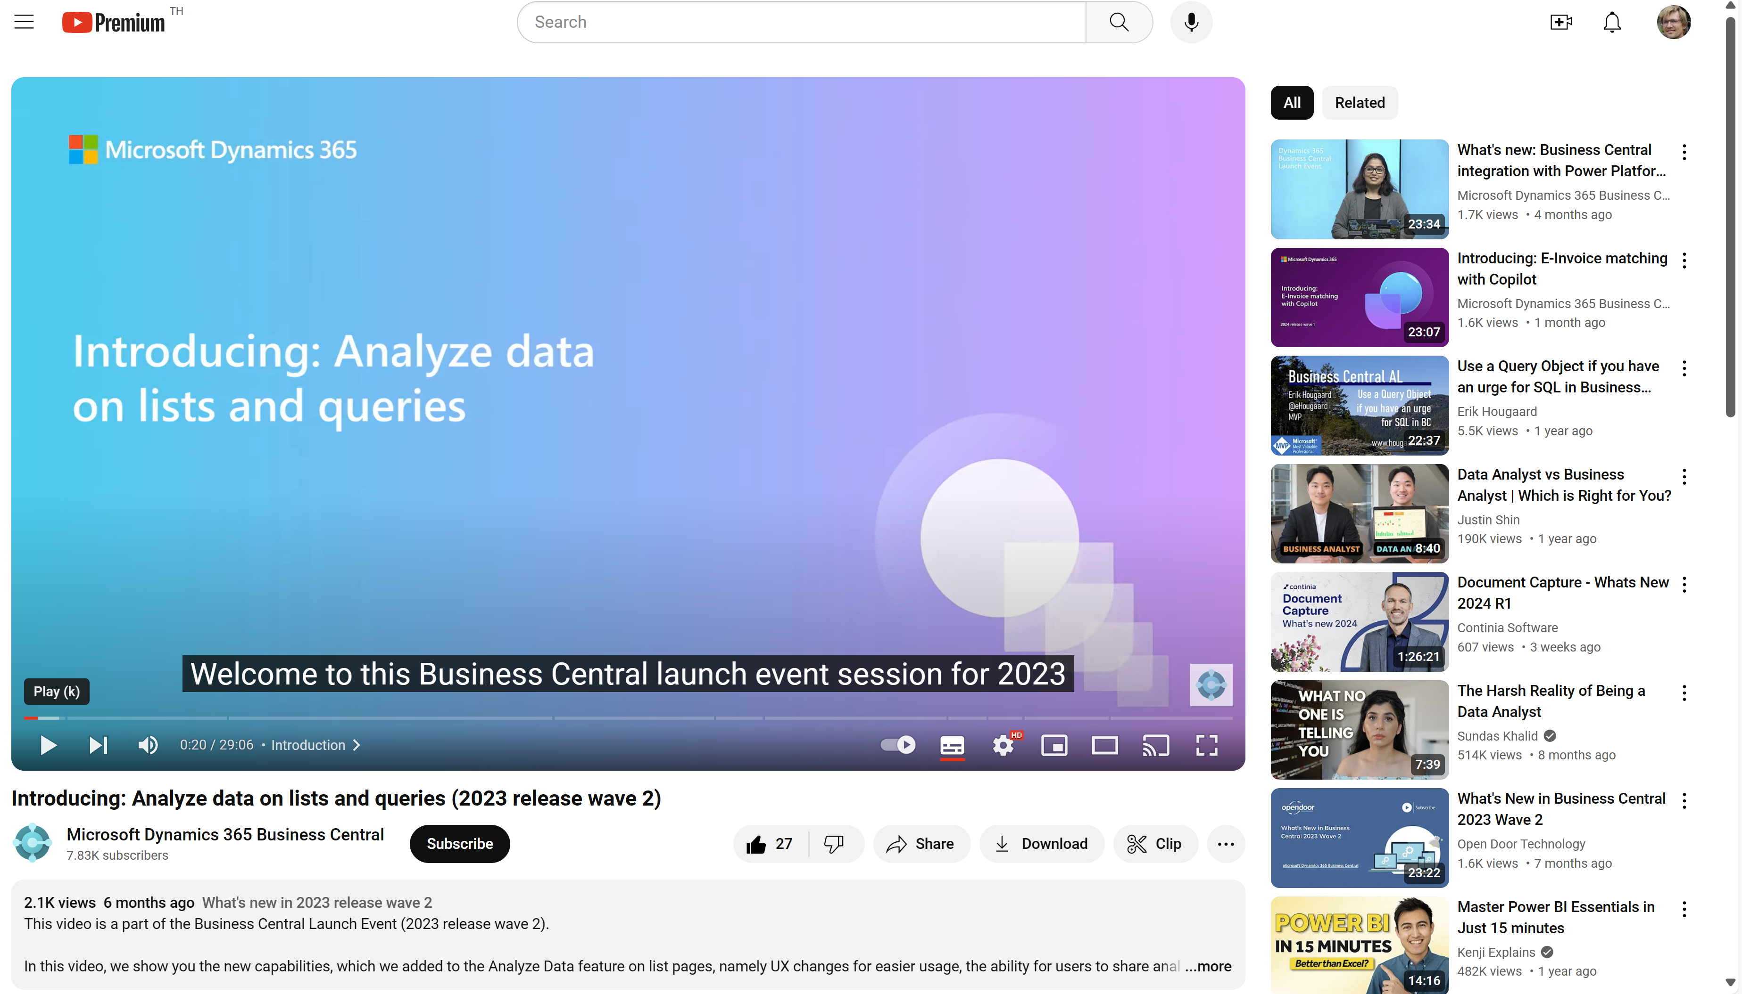
Watch the video to learn more…

Slide 29
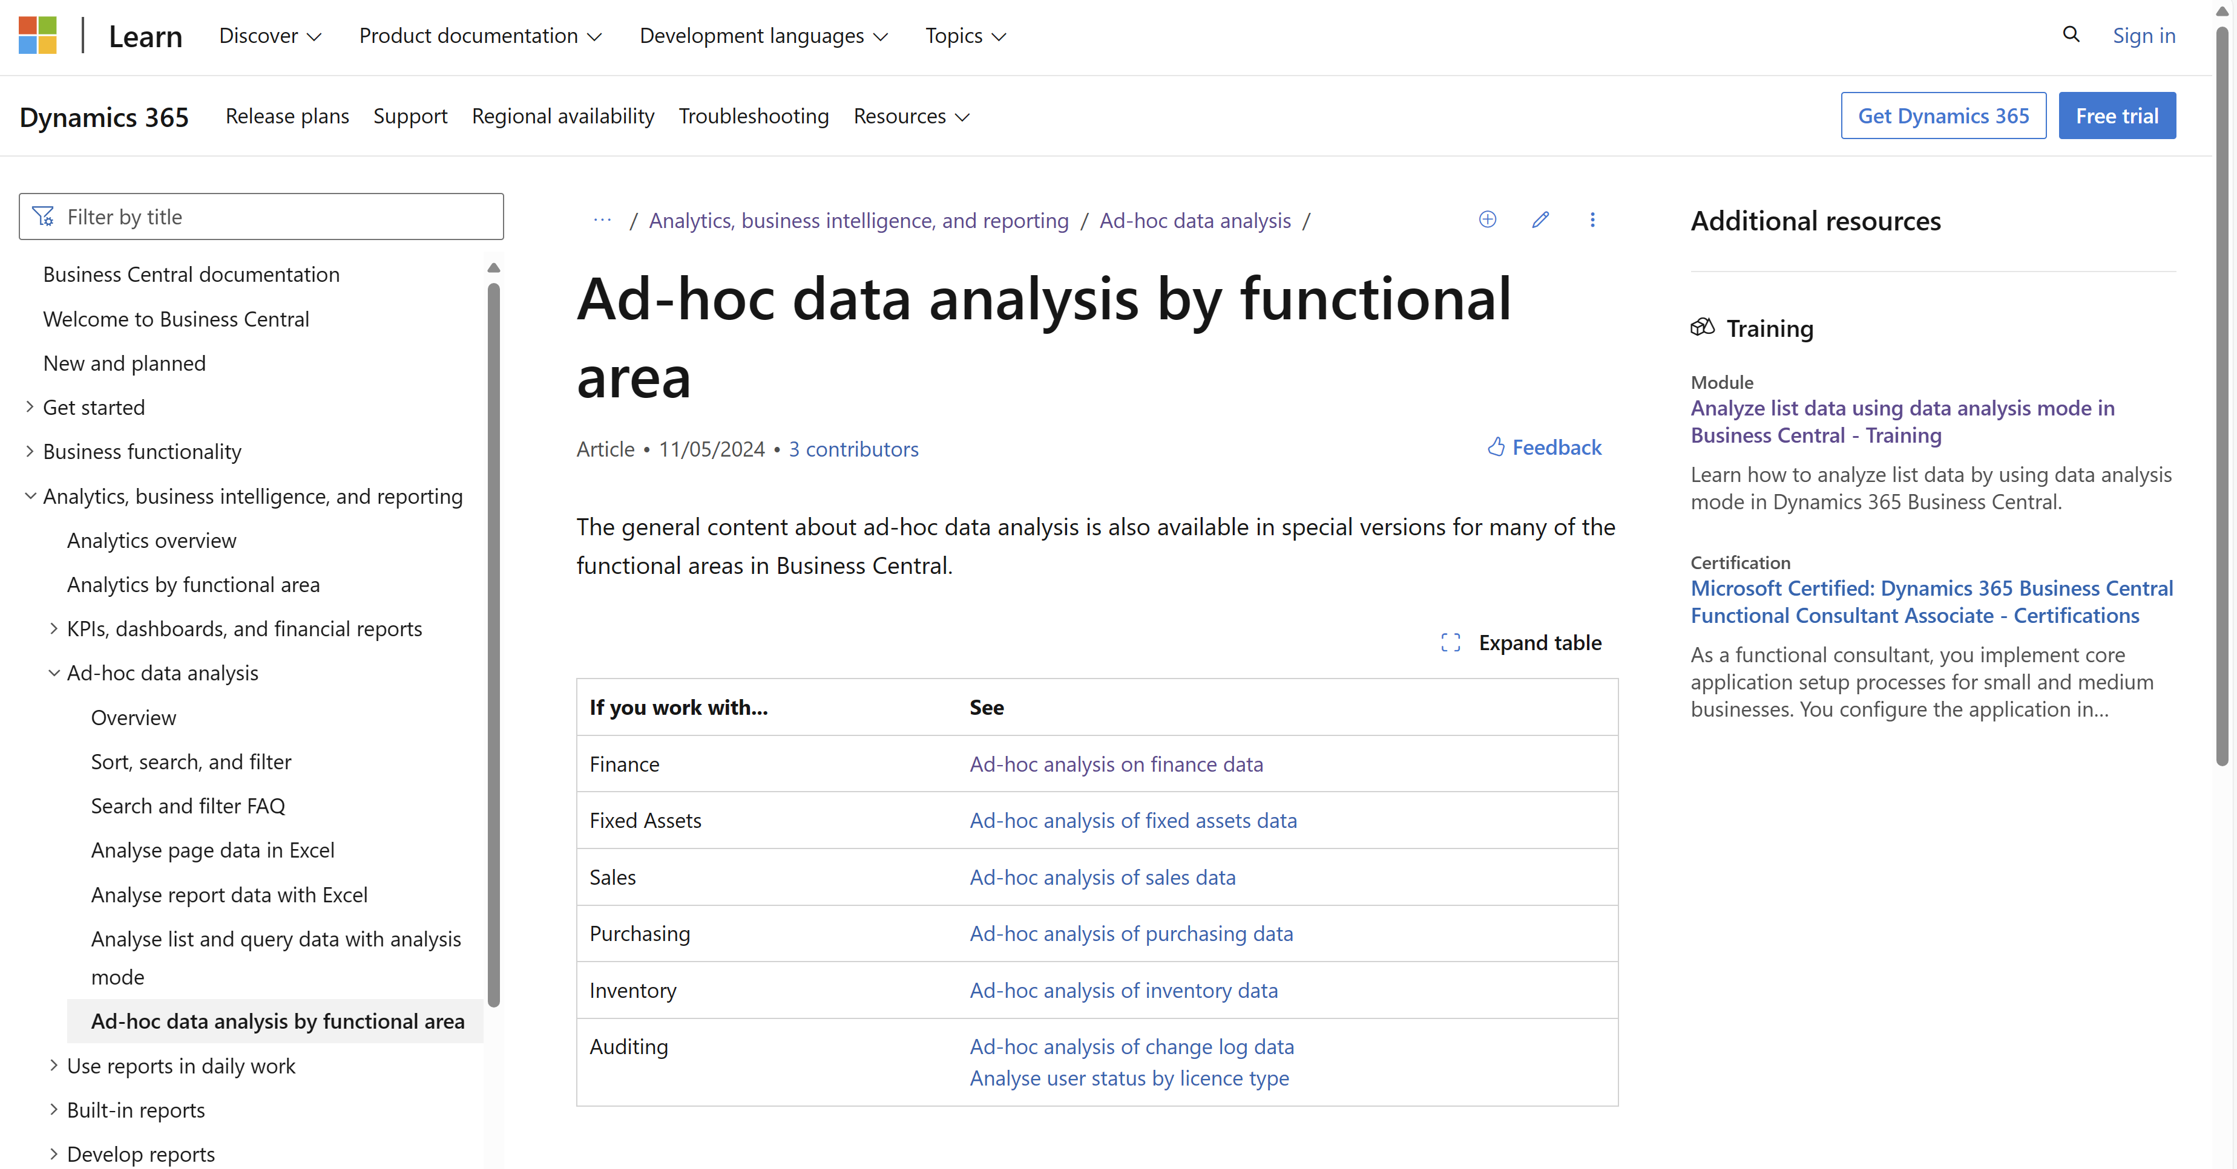
New documentation added (May 2024) aka.ms/bcAnalytics

Slide 30
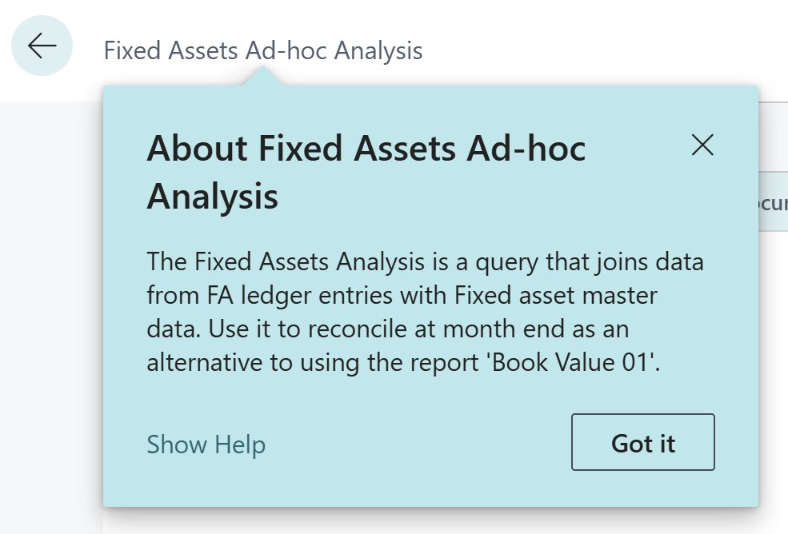
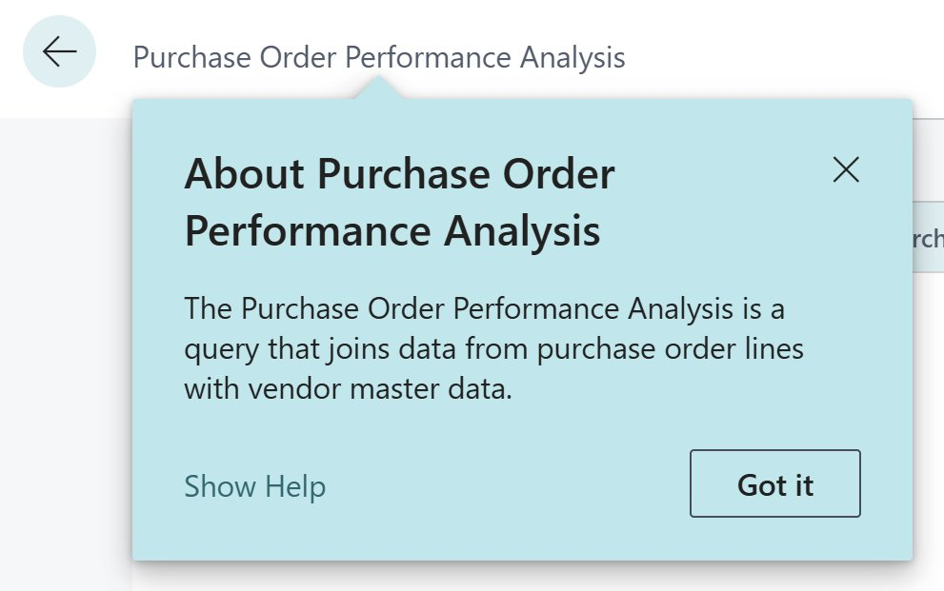
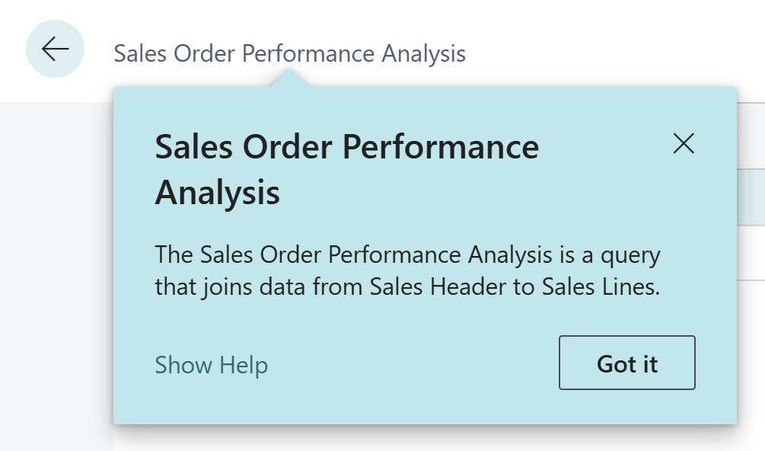
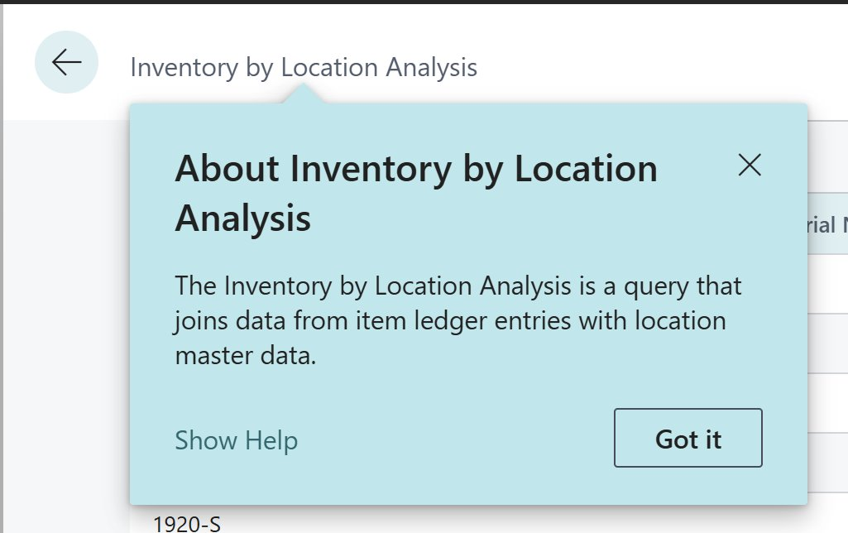
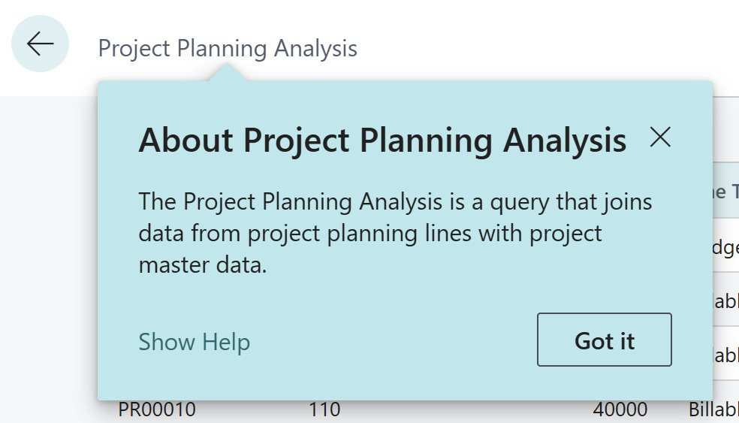
Queries added in 25.3 and 26.1

Slide 31
Finance Excel reports generally available in 26.0
Trial balance
Trial balance/budget
Trial balance by period
Trial balance/previous year
Consolidated trial balance
Aged Accounts Receivable
Aged Accounts Payables

Slide 32
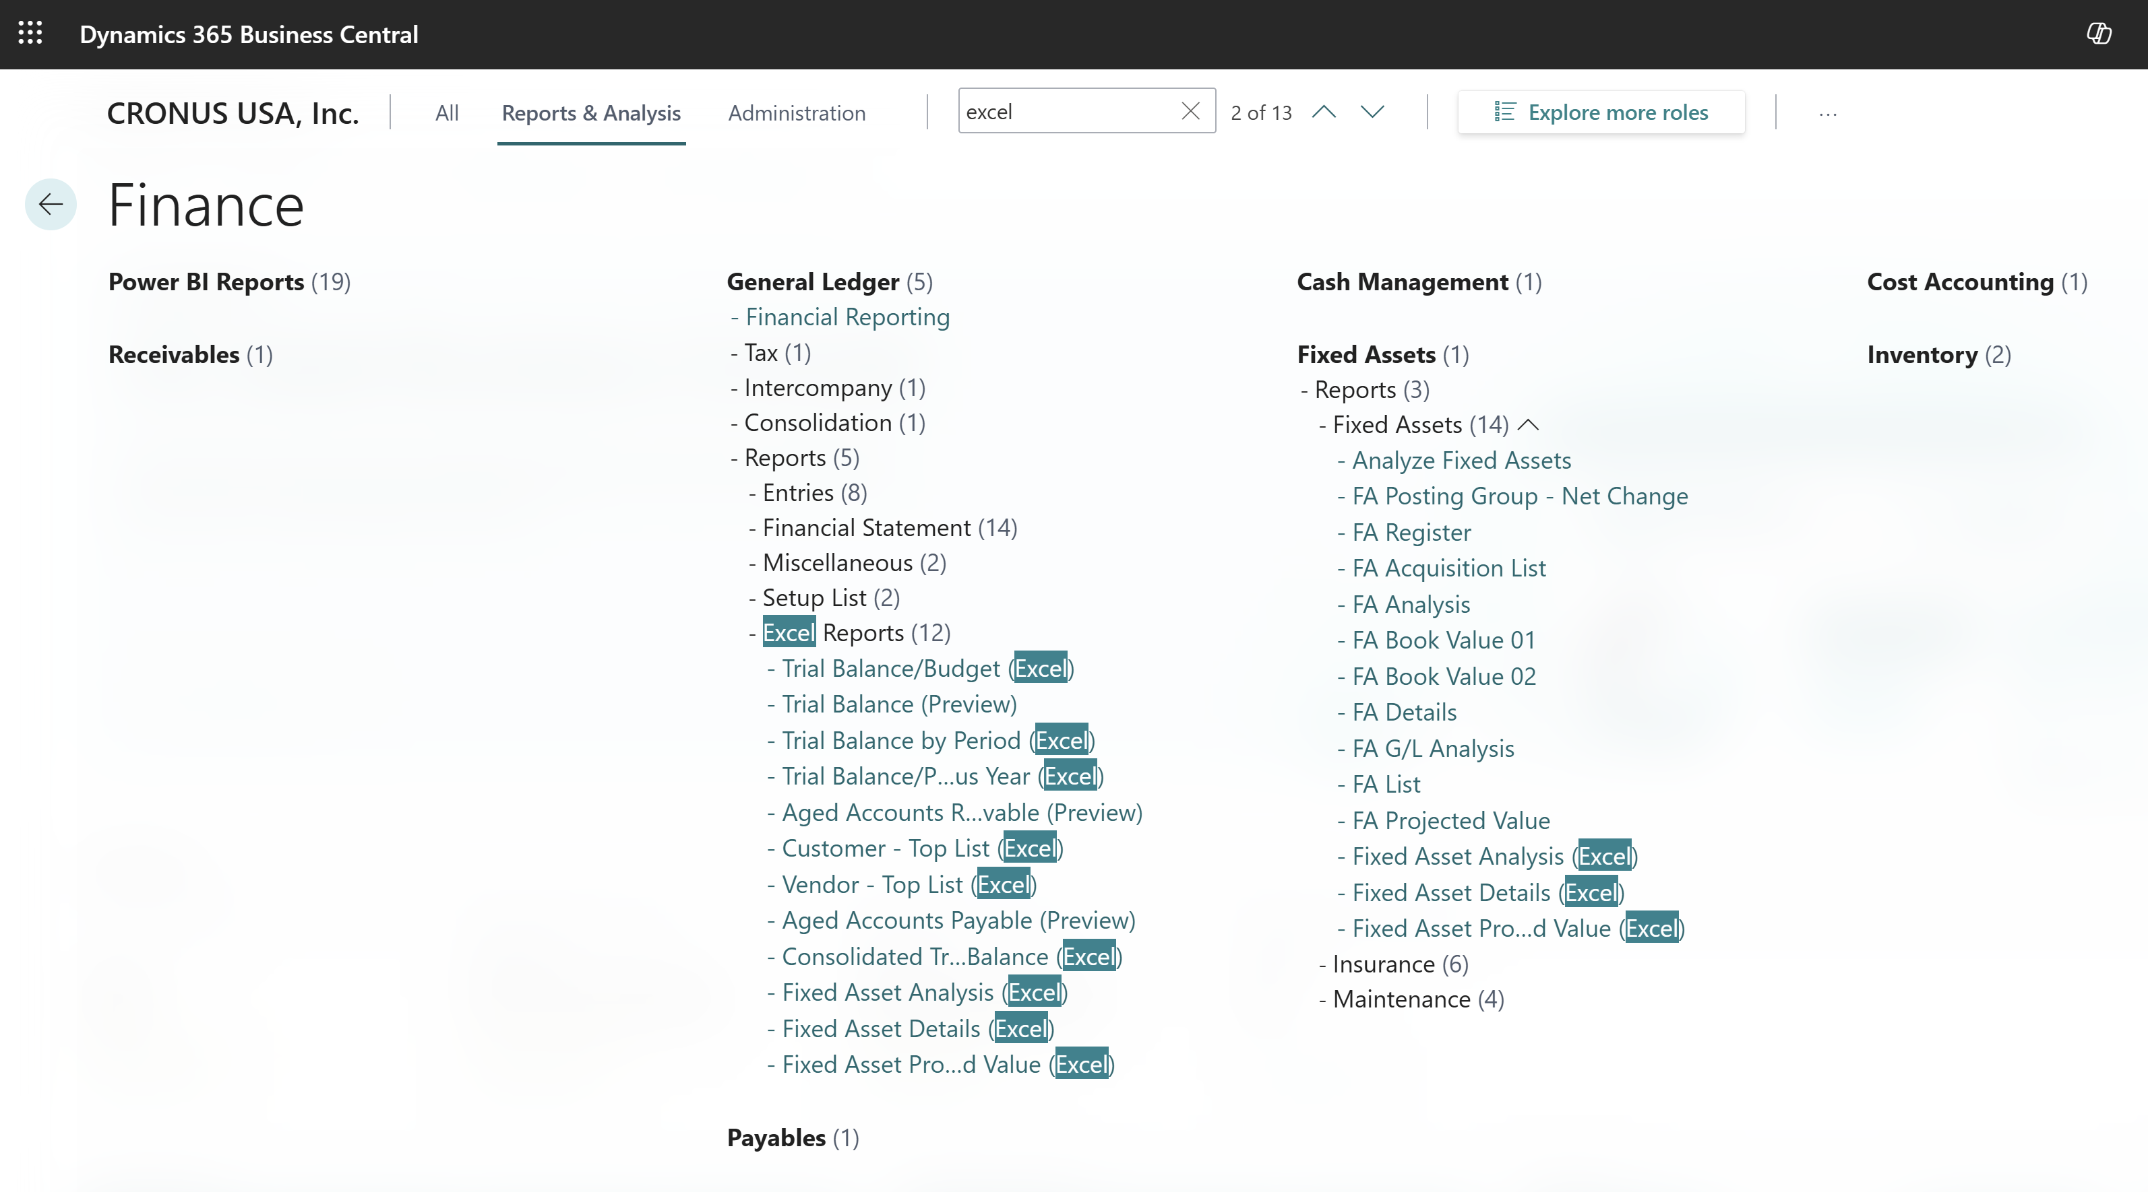
Find Excel reports for finance in the report explorer

Slide 33
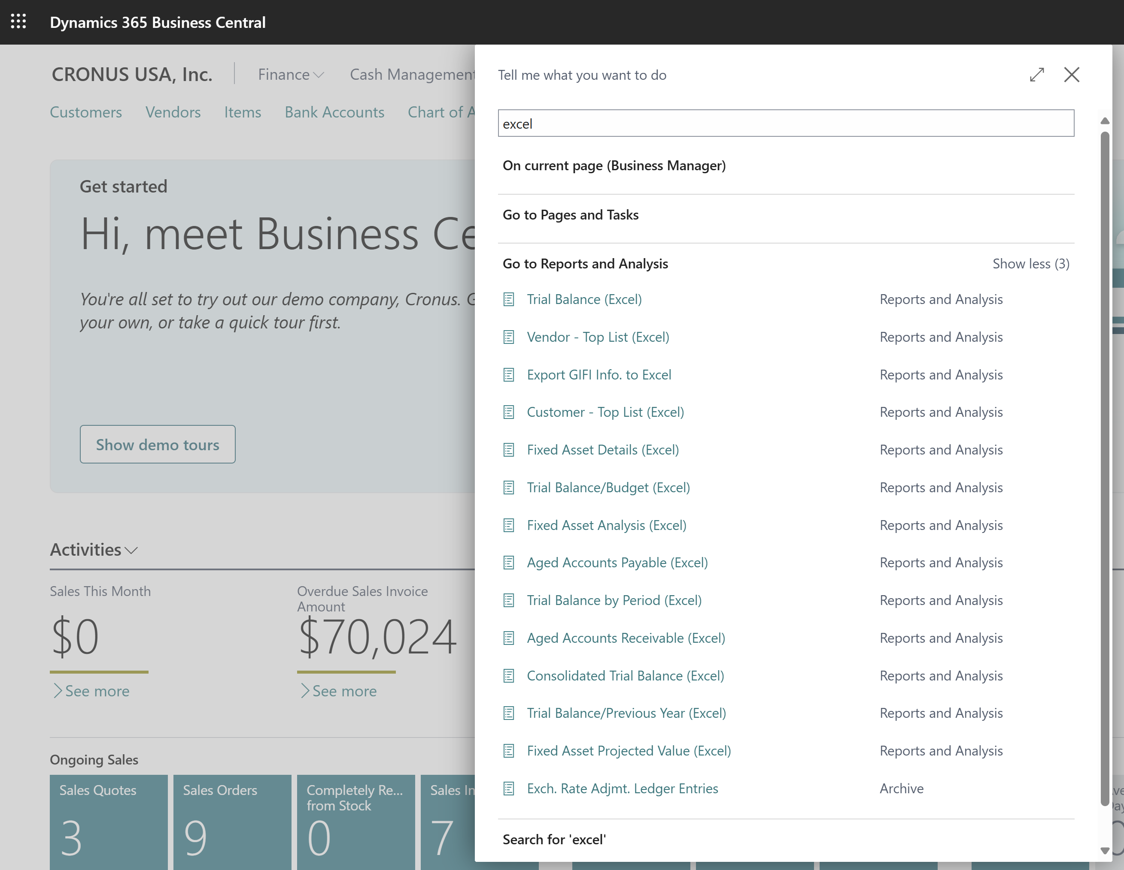
Find Excel reports with Tell Me search

Slide 34
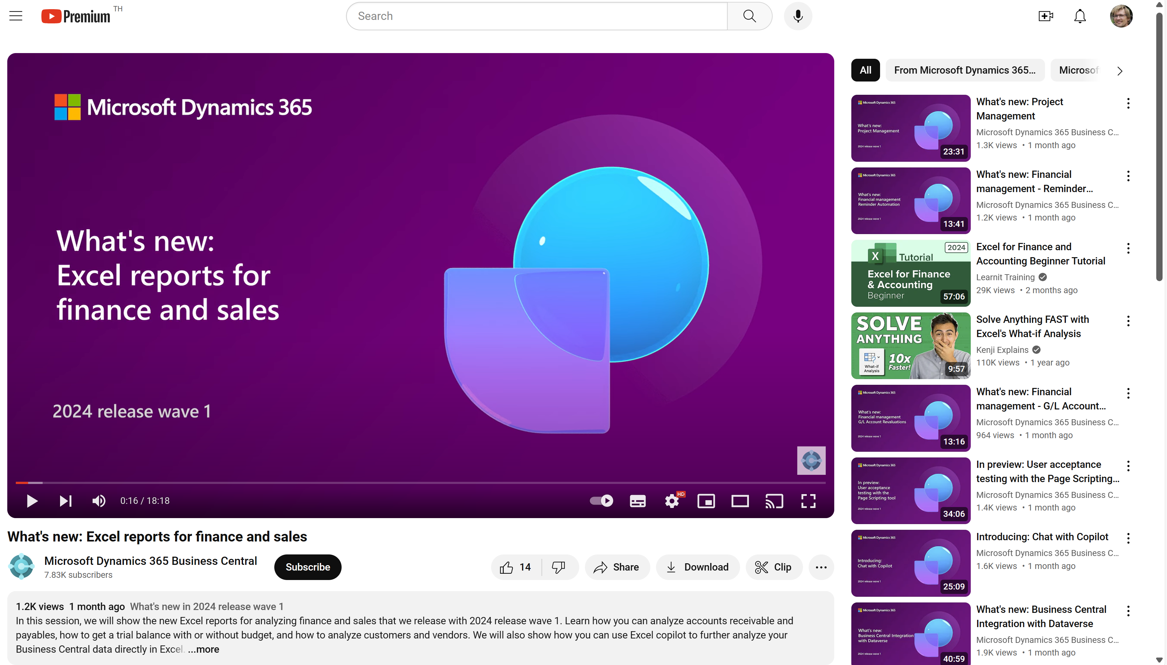
Watch the video to learn more…
Notes:
This video shows the new Excel reports that were shipped in preview 2024w1

Slide 35
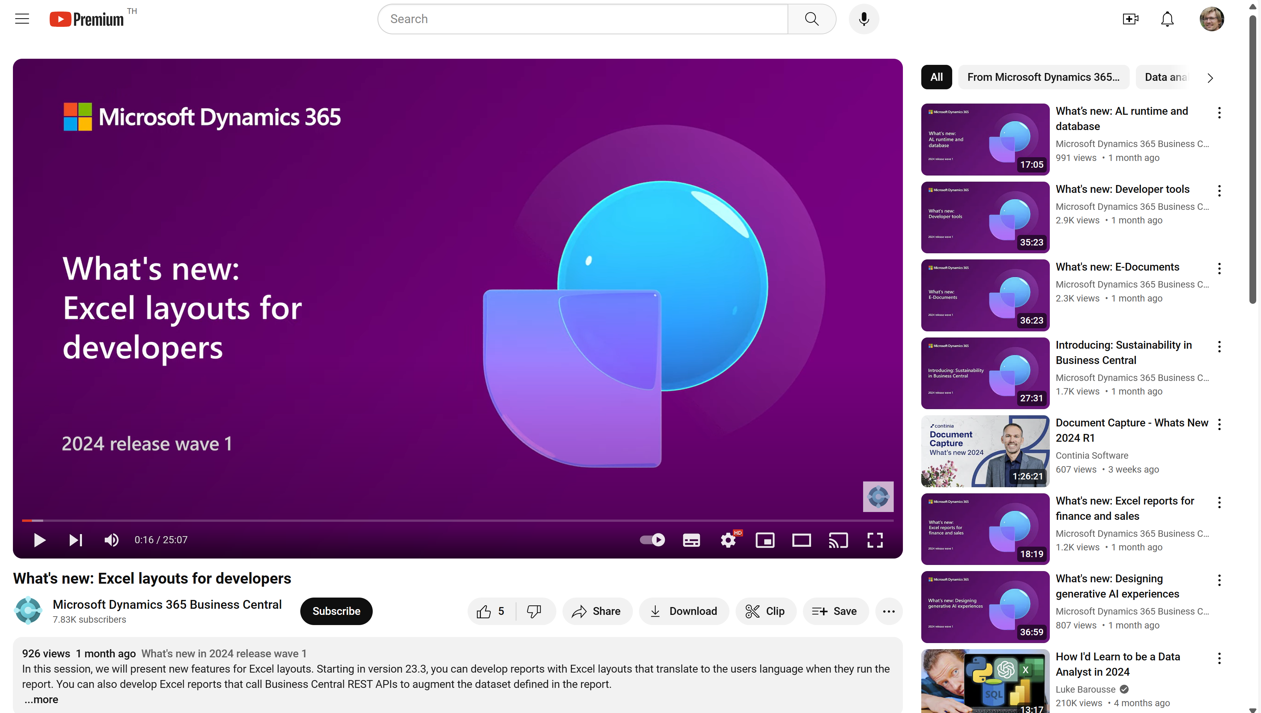
Watch the video to learn more…
Notes:
This video shows the new Excel layout features that were shipped in 2024w1

Slide 36
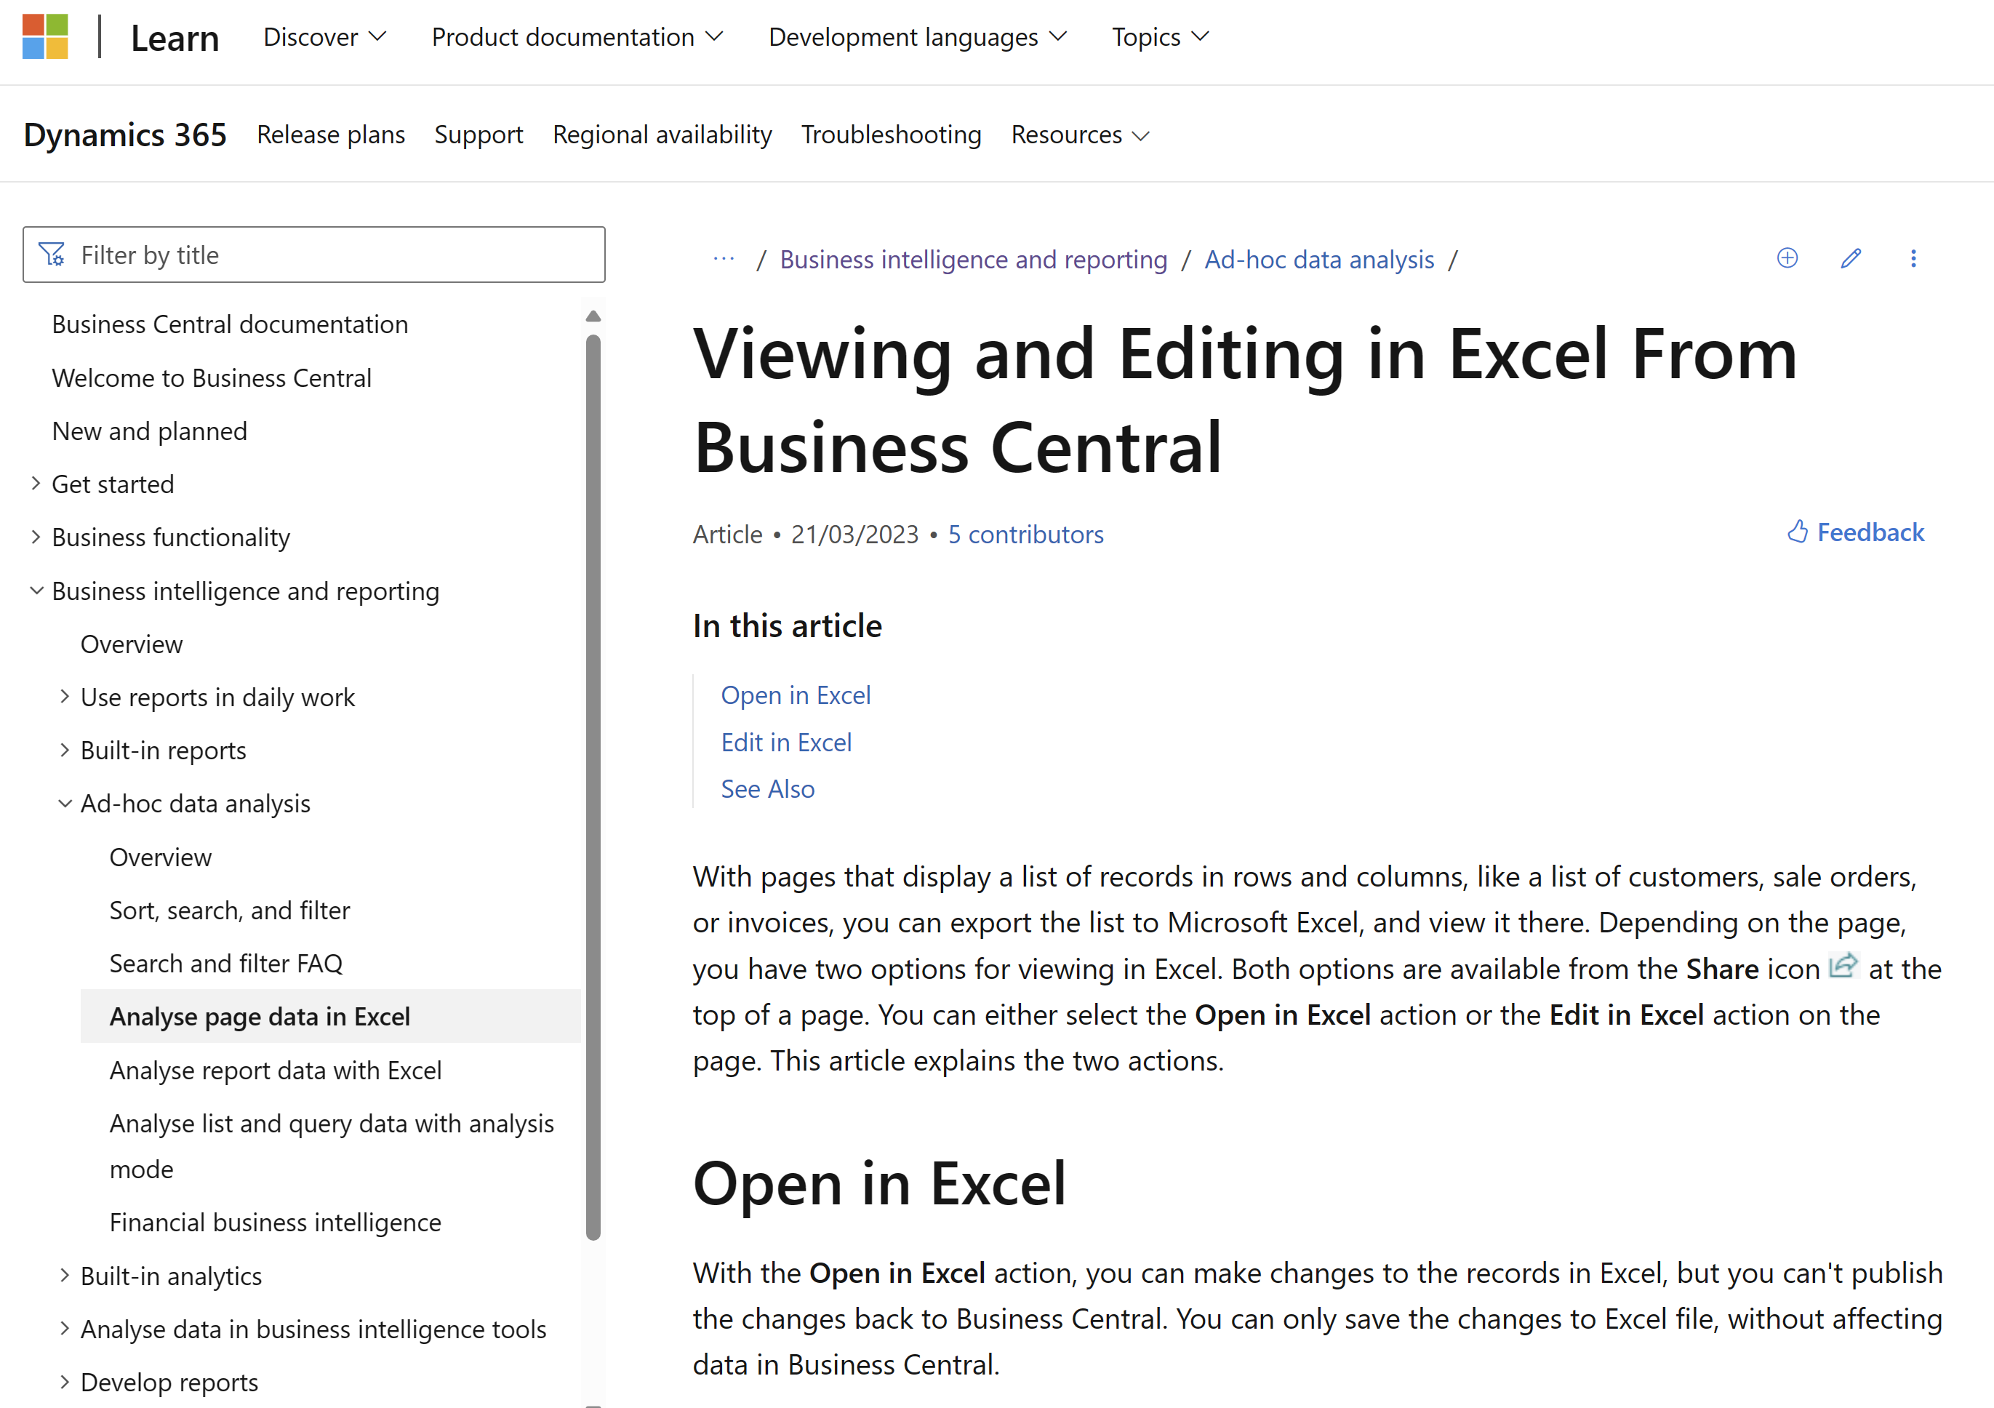
Want to learn more? aka.ms/bcReporting
Notes:
The section in user docs that explains how Excel fits into the analytics story (when consuming data)

Slide 37
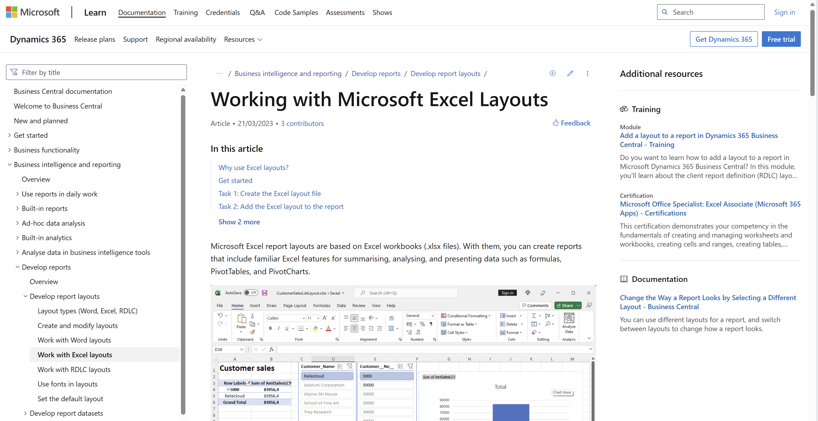
aka.ms/bcReporting
Notes:
The section in user docs that explains how Excel layouts work

Slide 38
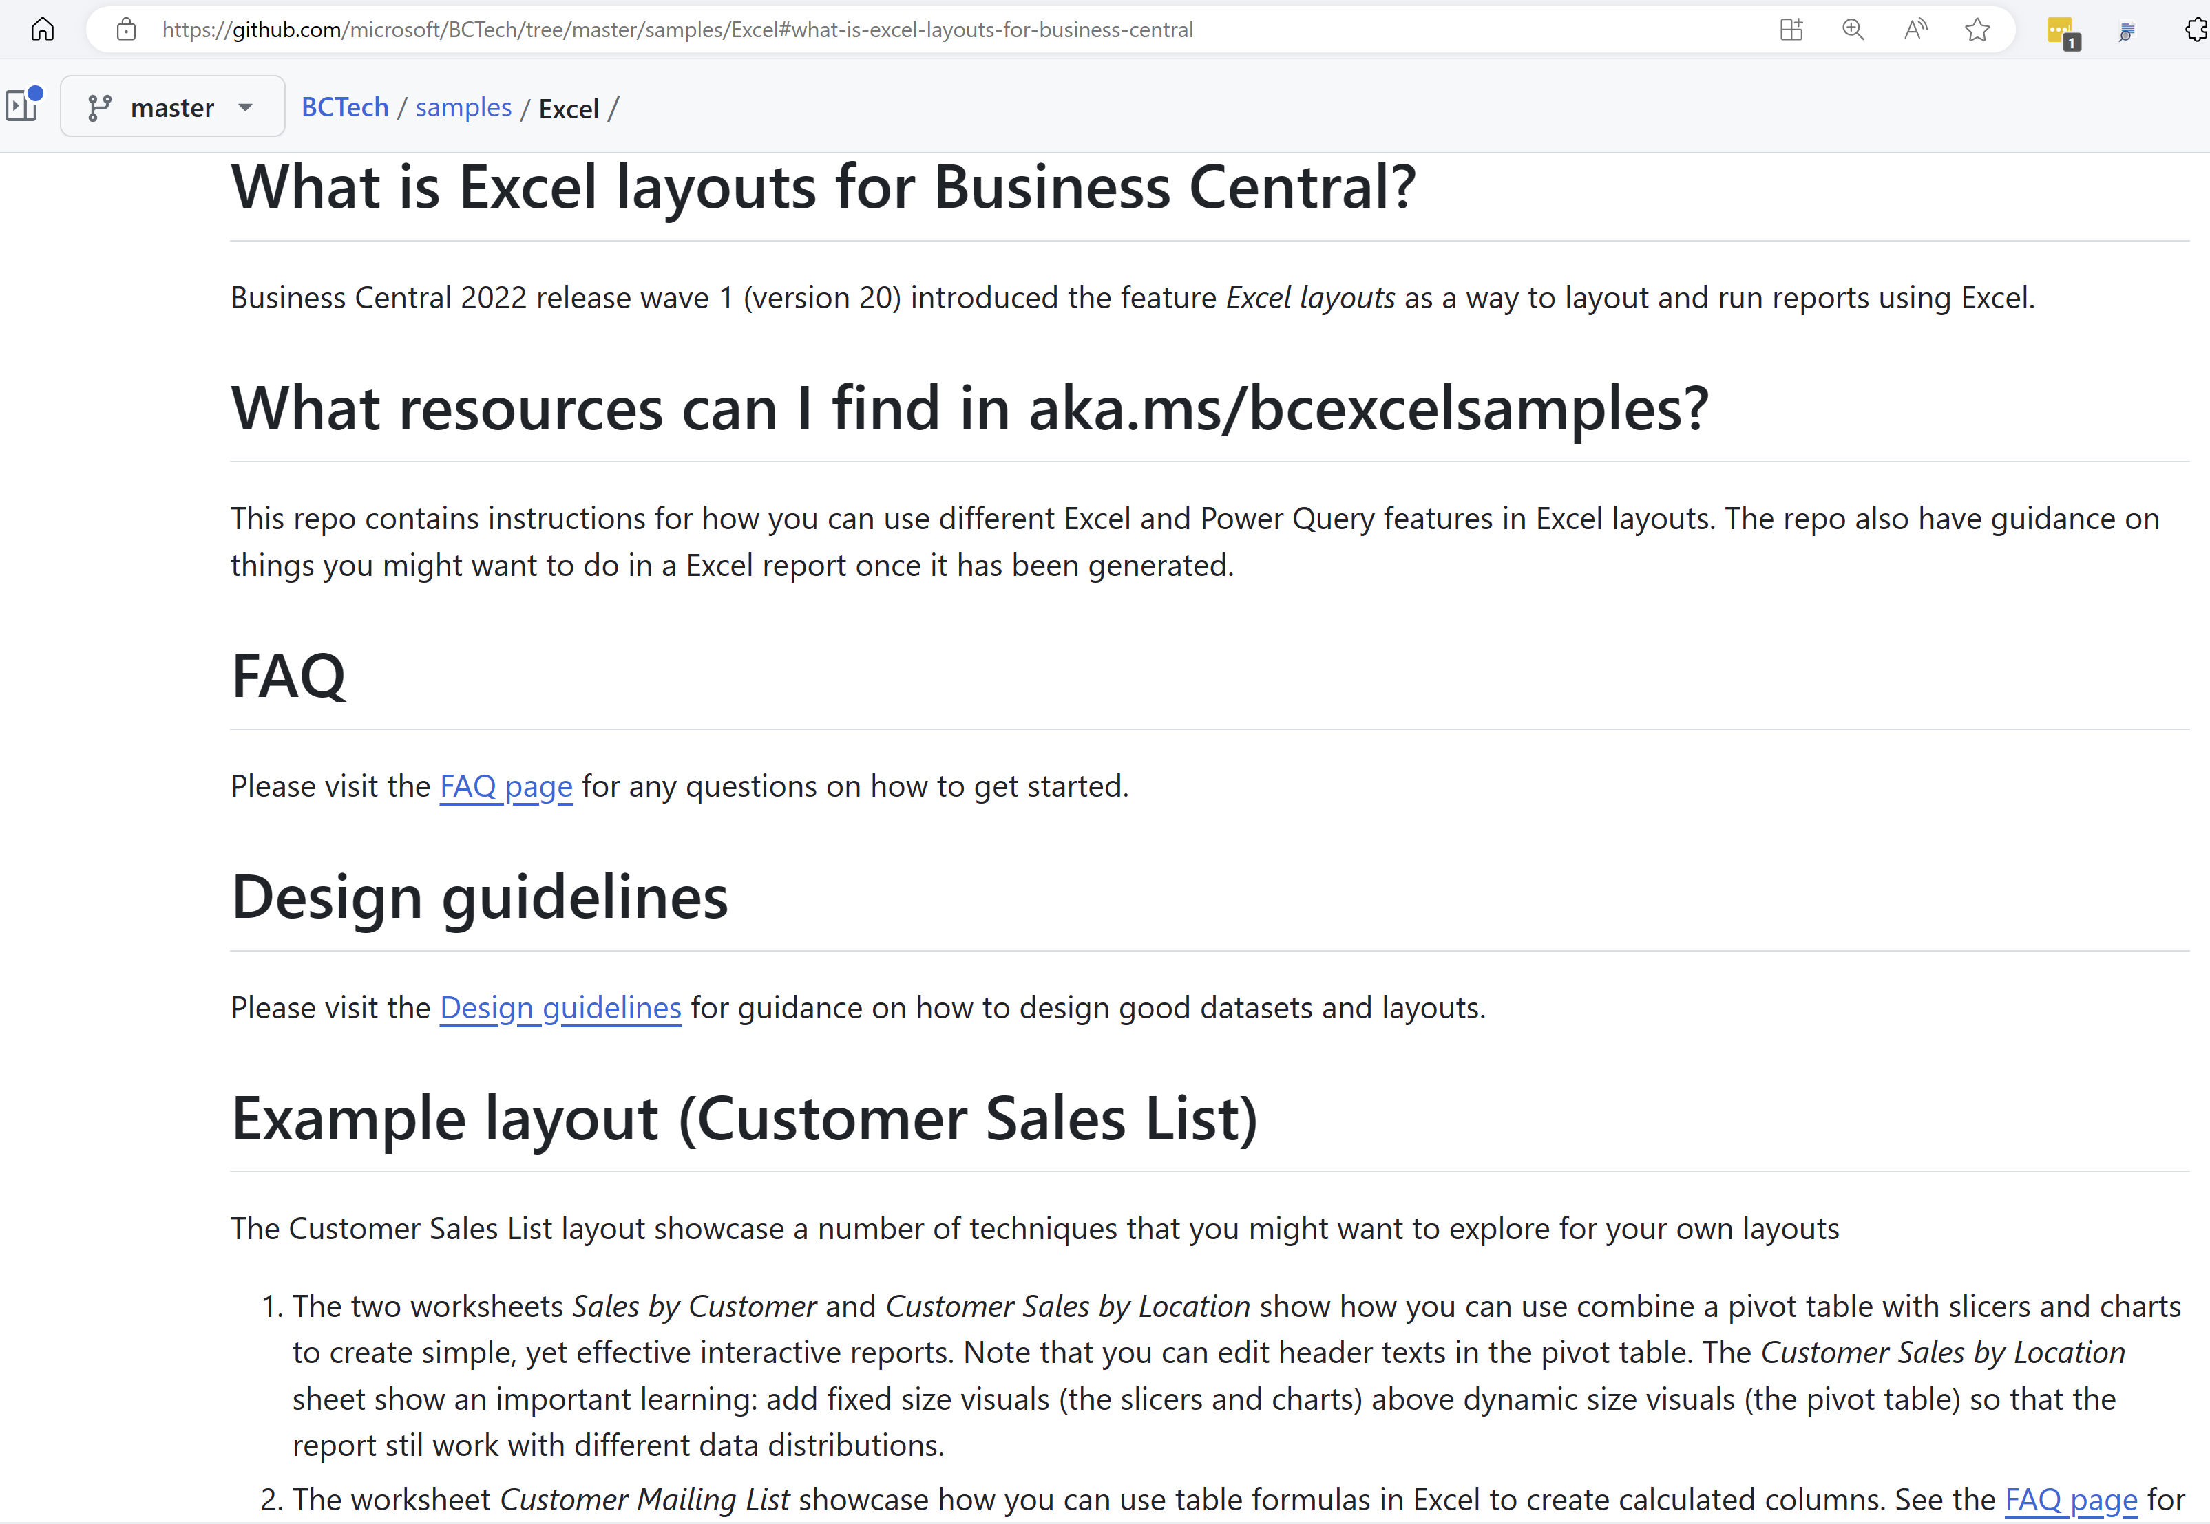
Want to learn through examples? aka.ms/ bcExcelSamples
Notes:
Sample code for learning different techniques. Work with existing reports

Slide 39
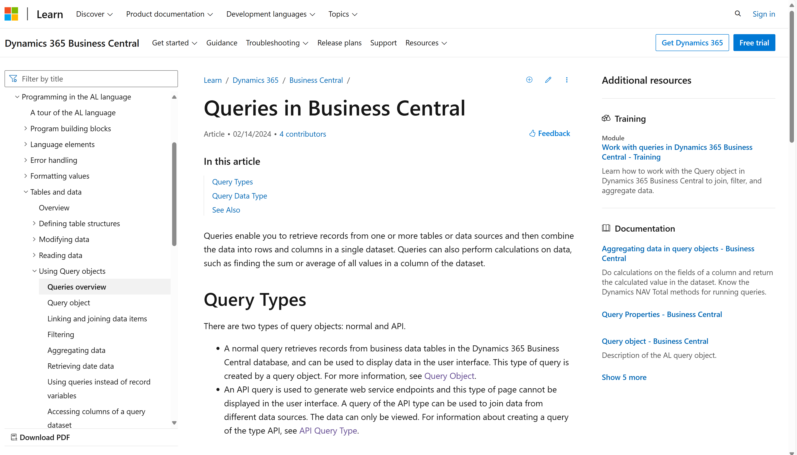
Want to learn more about AL queries?

Slide 40
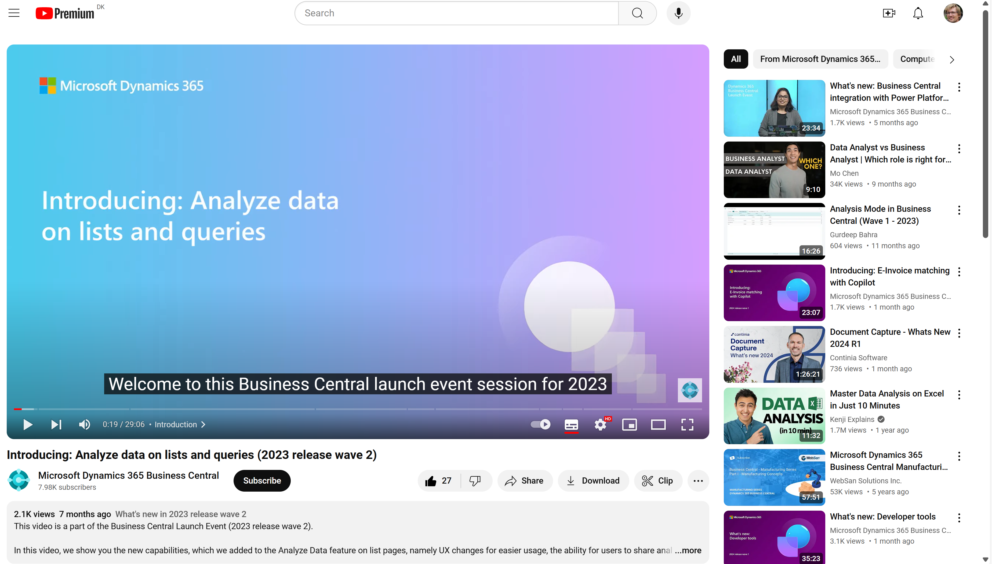
Watch the video to learn more…
Notes:
https://www.youtube.com/watch?v=qmLVKyHRhNc

Slide 41
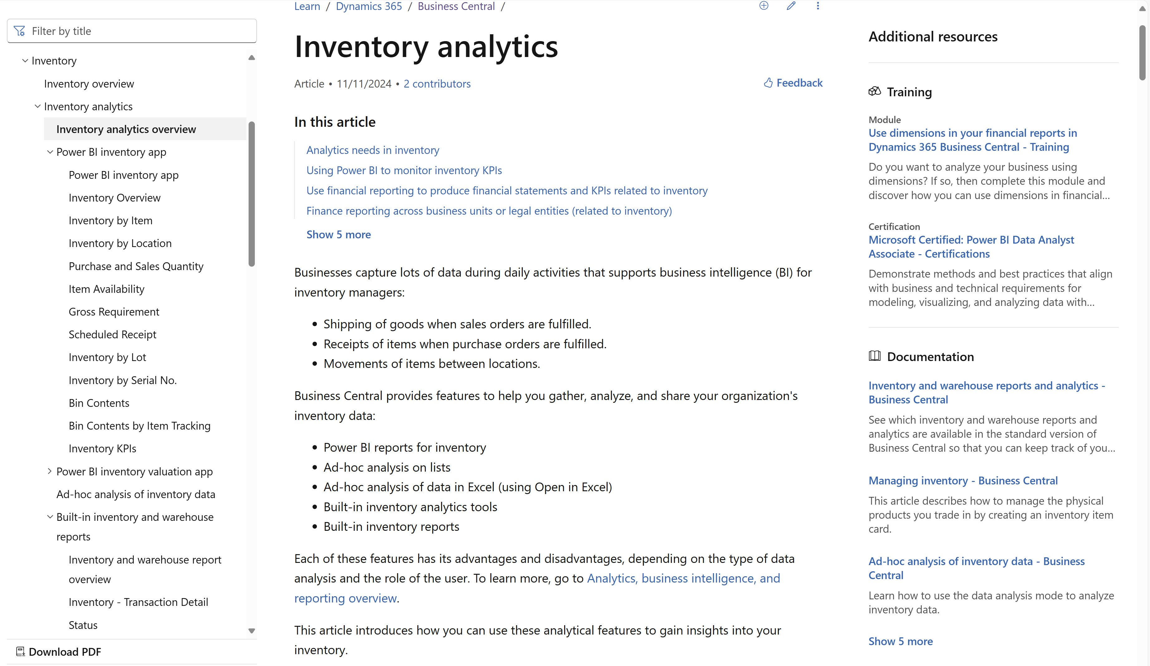
aka.ms/bcInventoryAnalytics
Notes:
Landing page in Microsoft Learn for all things related to analytics and reporting on inventory

Slide 42
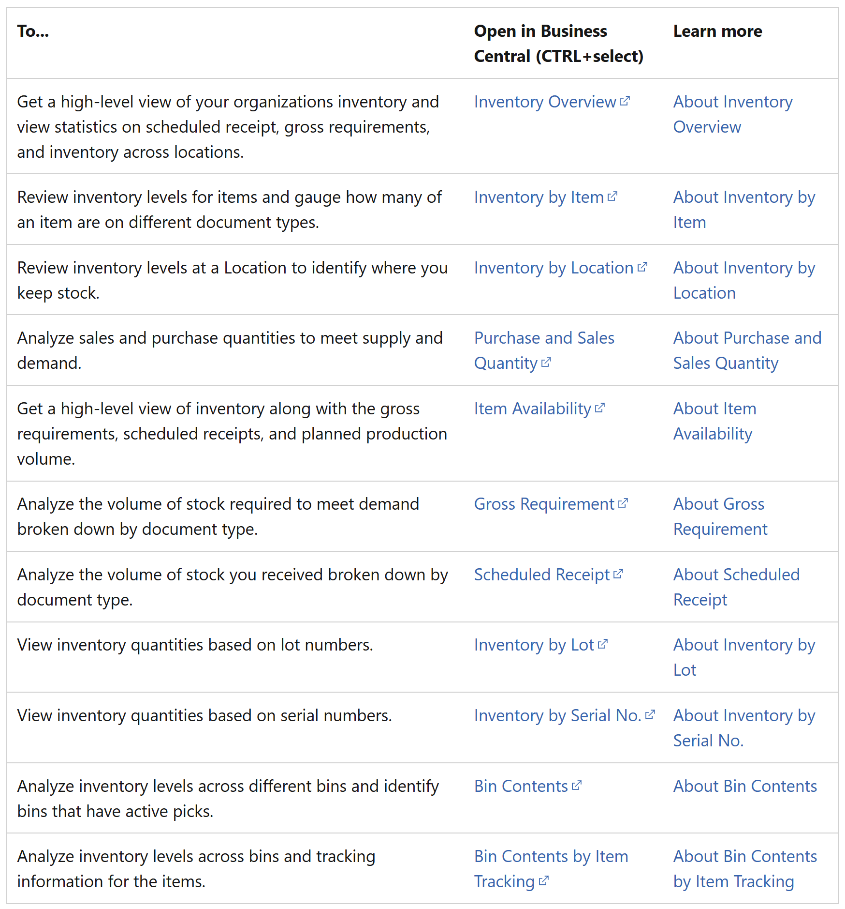
Inventory Power BI app
Notes:
11 report pages

Slide 43
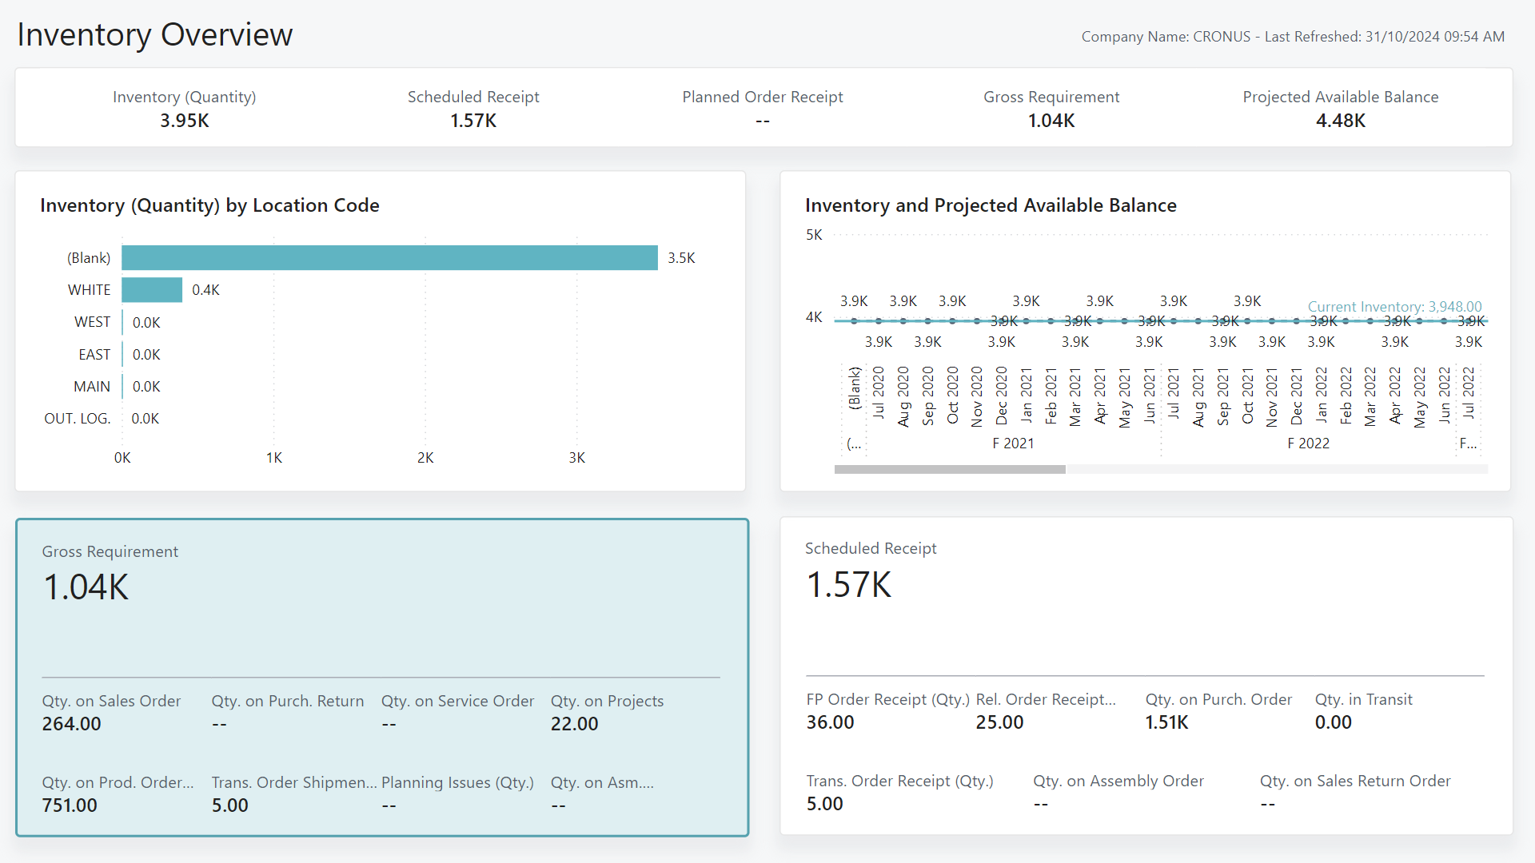
Notes:
Go to Microsoft learn to get screenshots for the other 10 report pages.
Or just install the App in Power BI and demo it with demo data

Slide 44
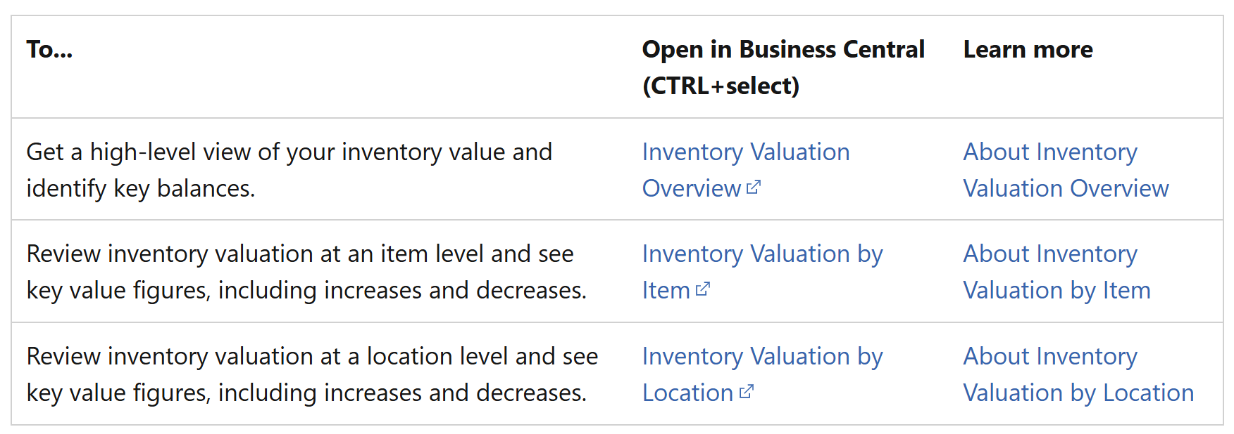
Inventory Valuation Power BI app
Notes:
3 report pages

Slide 45
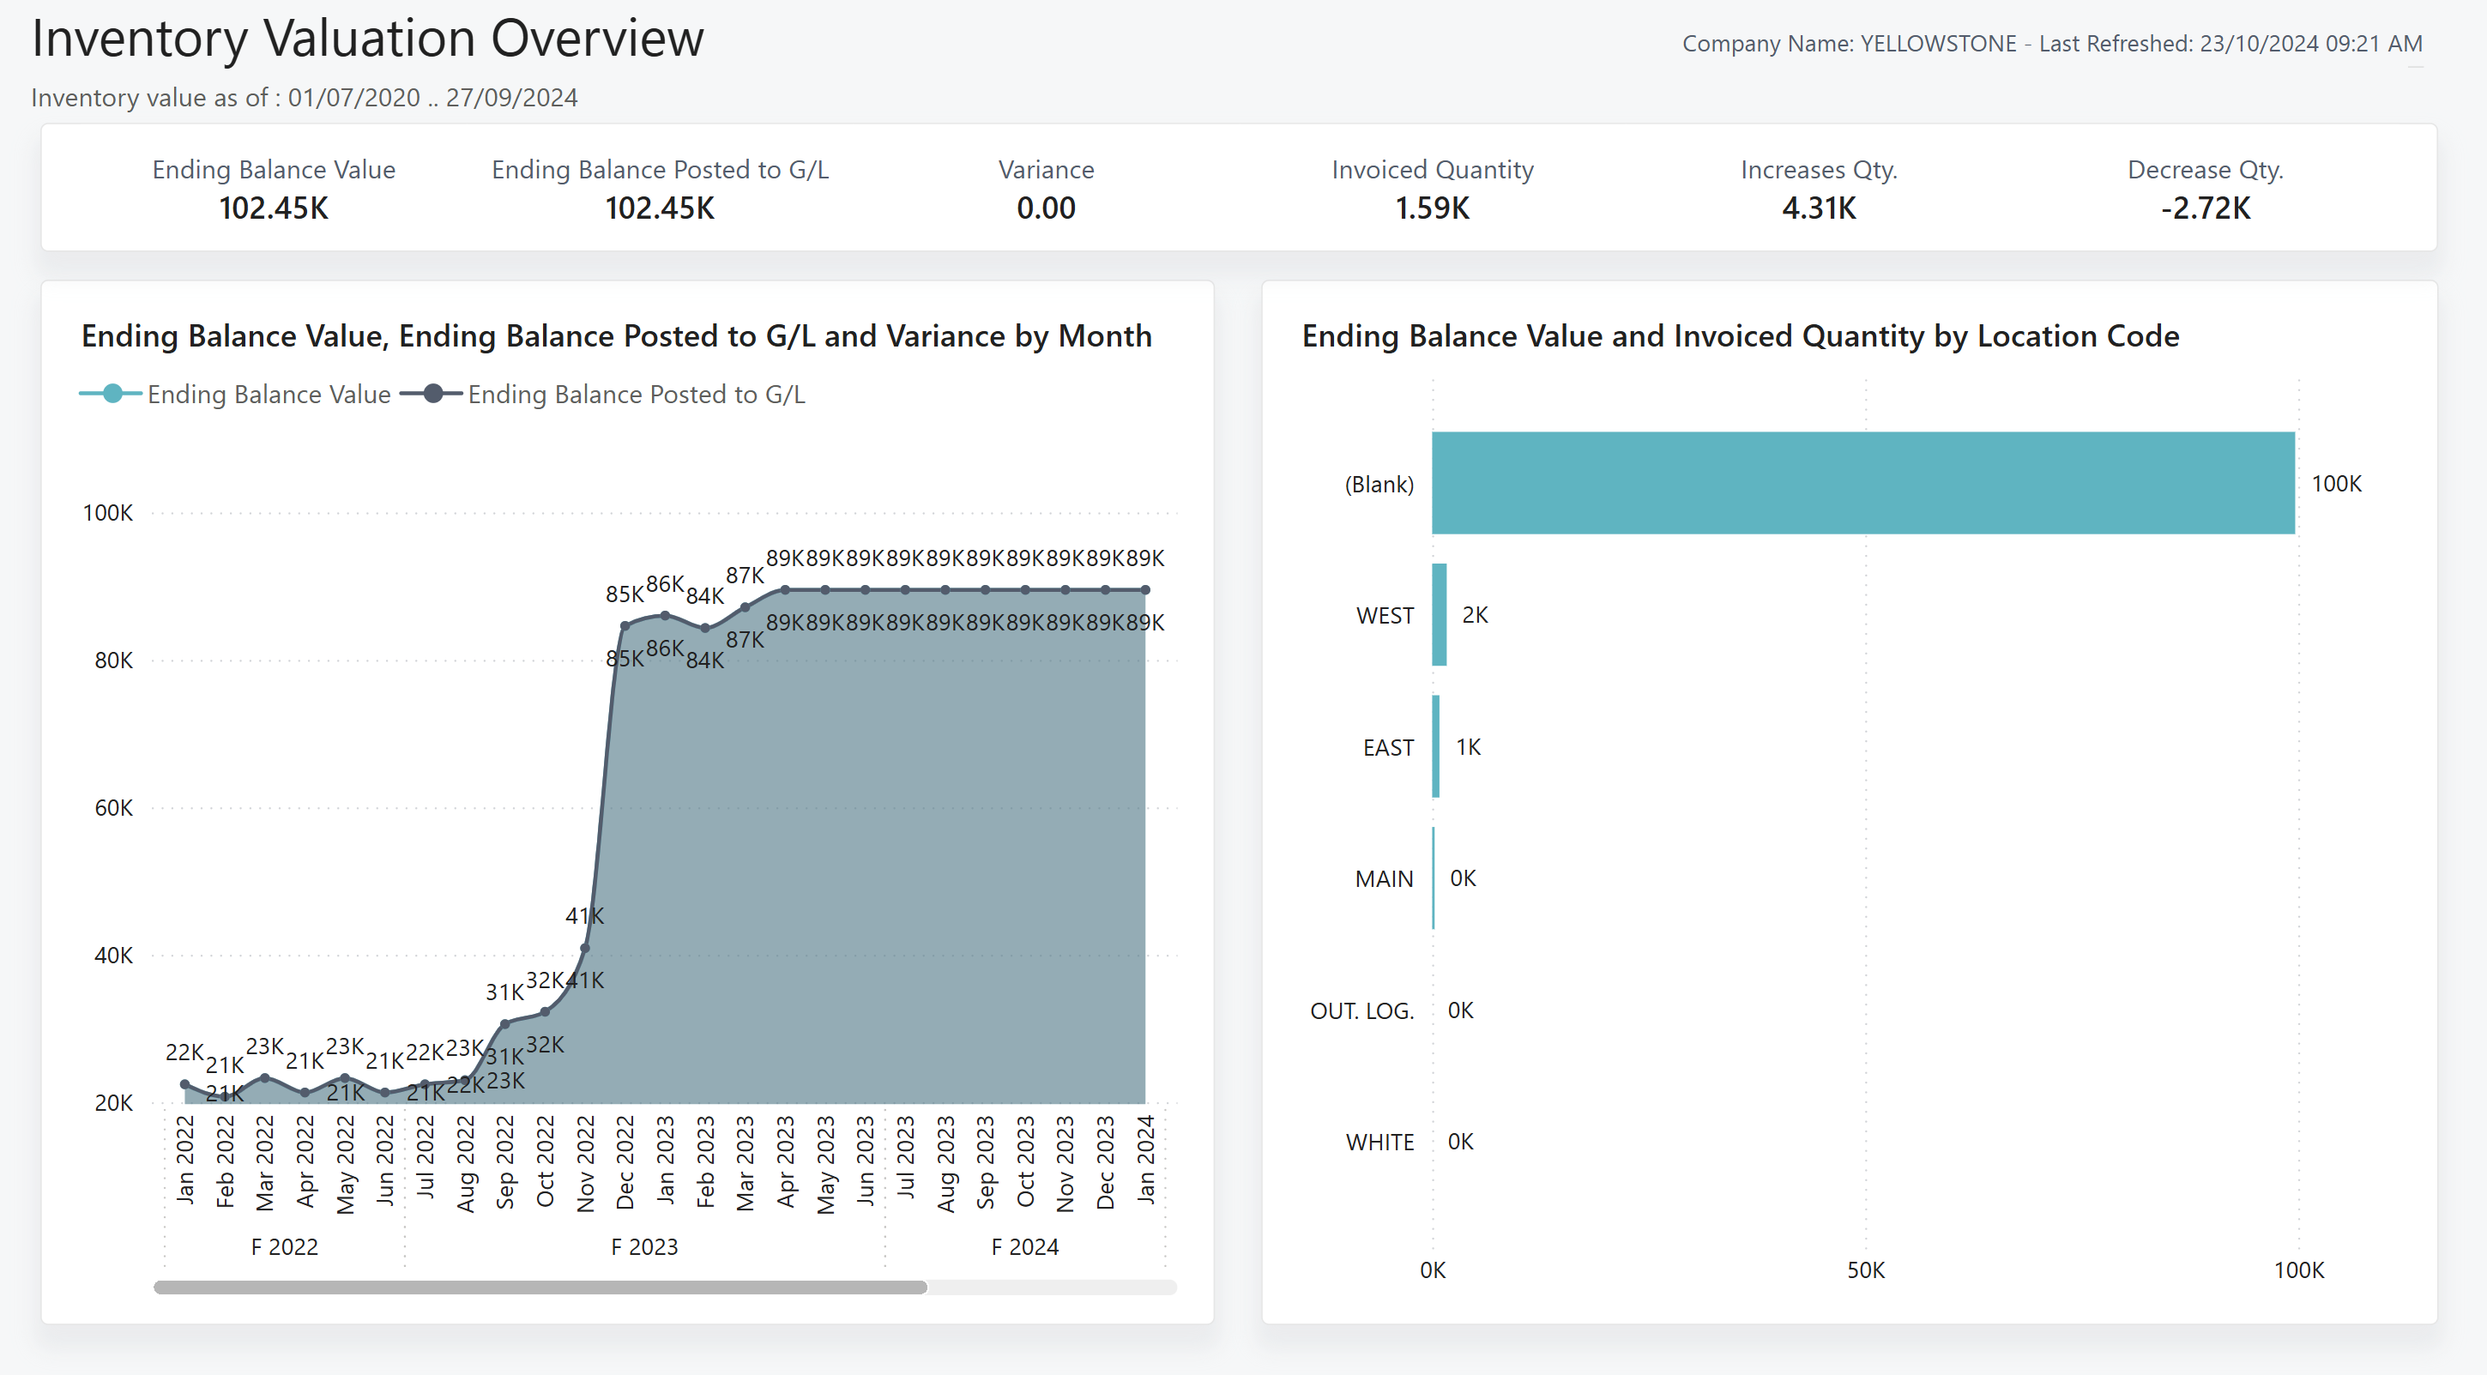
Notes:
Go to Microsoft learn to get screenshots for the other 2 report pages.
Or just install the App in Power BI and demo it with demo data

Slide 46
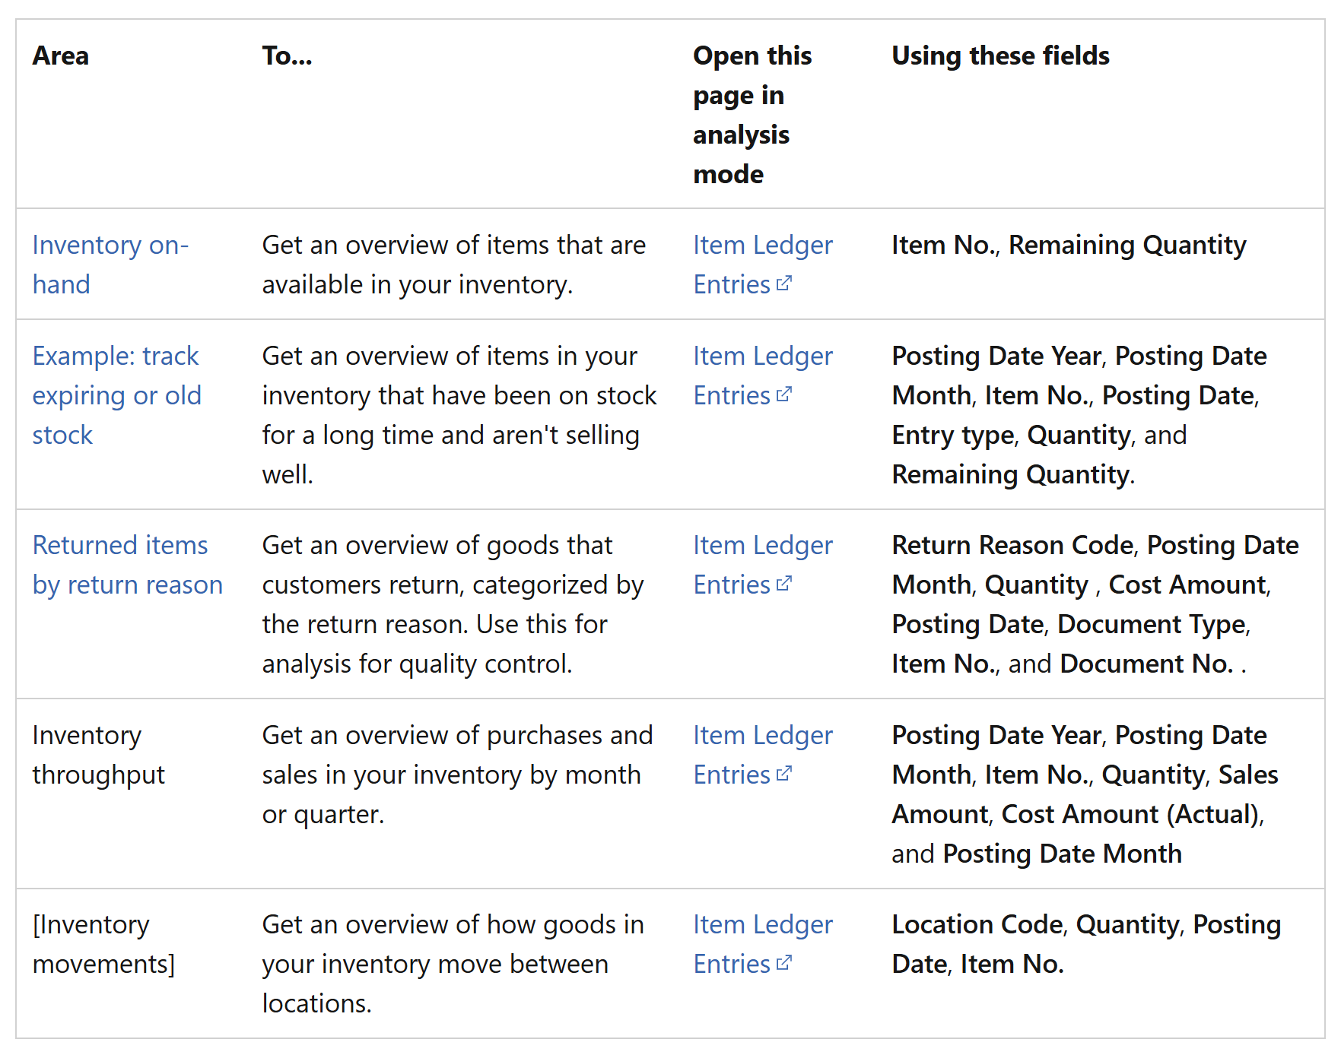
Inventory ad-hoc analysis scenarios
Notes:
Go to the article
Ad-hoc analysis of inventory data - Business Central | Microsoft Learn
and try a few scenarios.

Slide 47
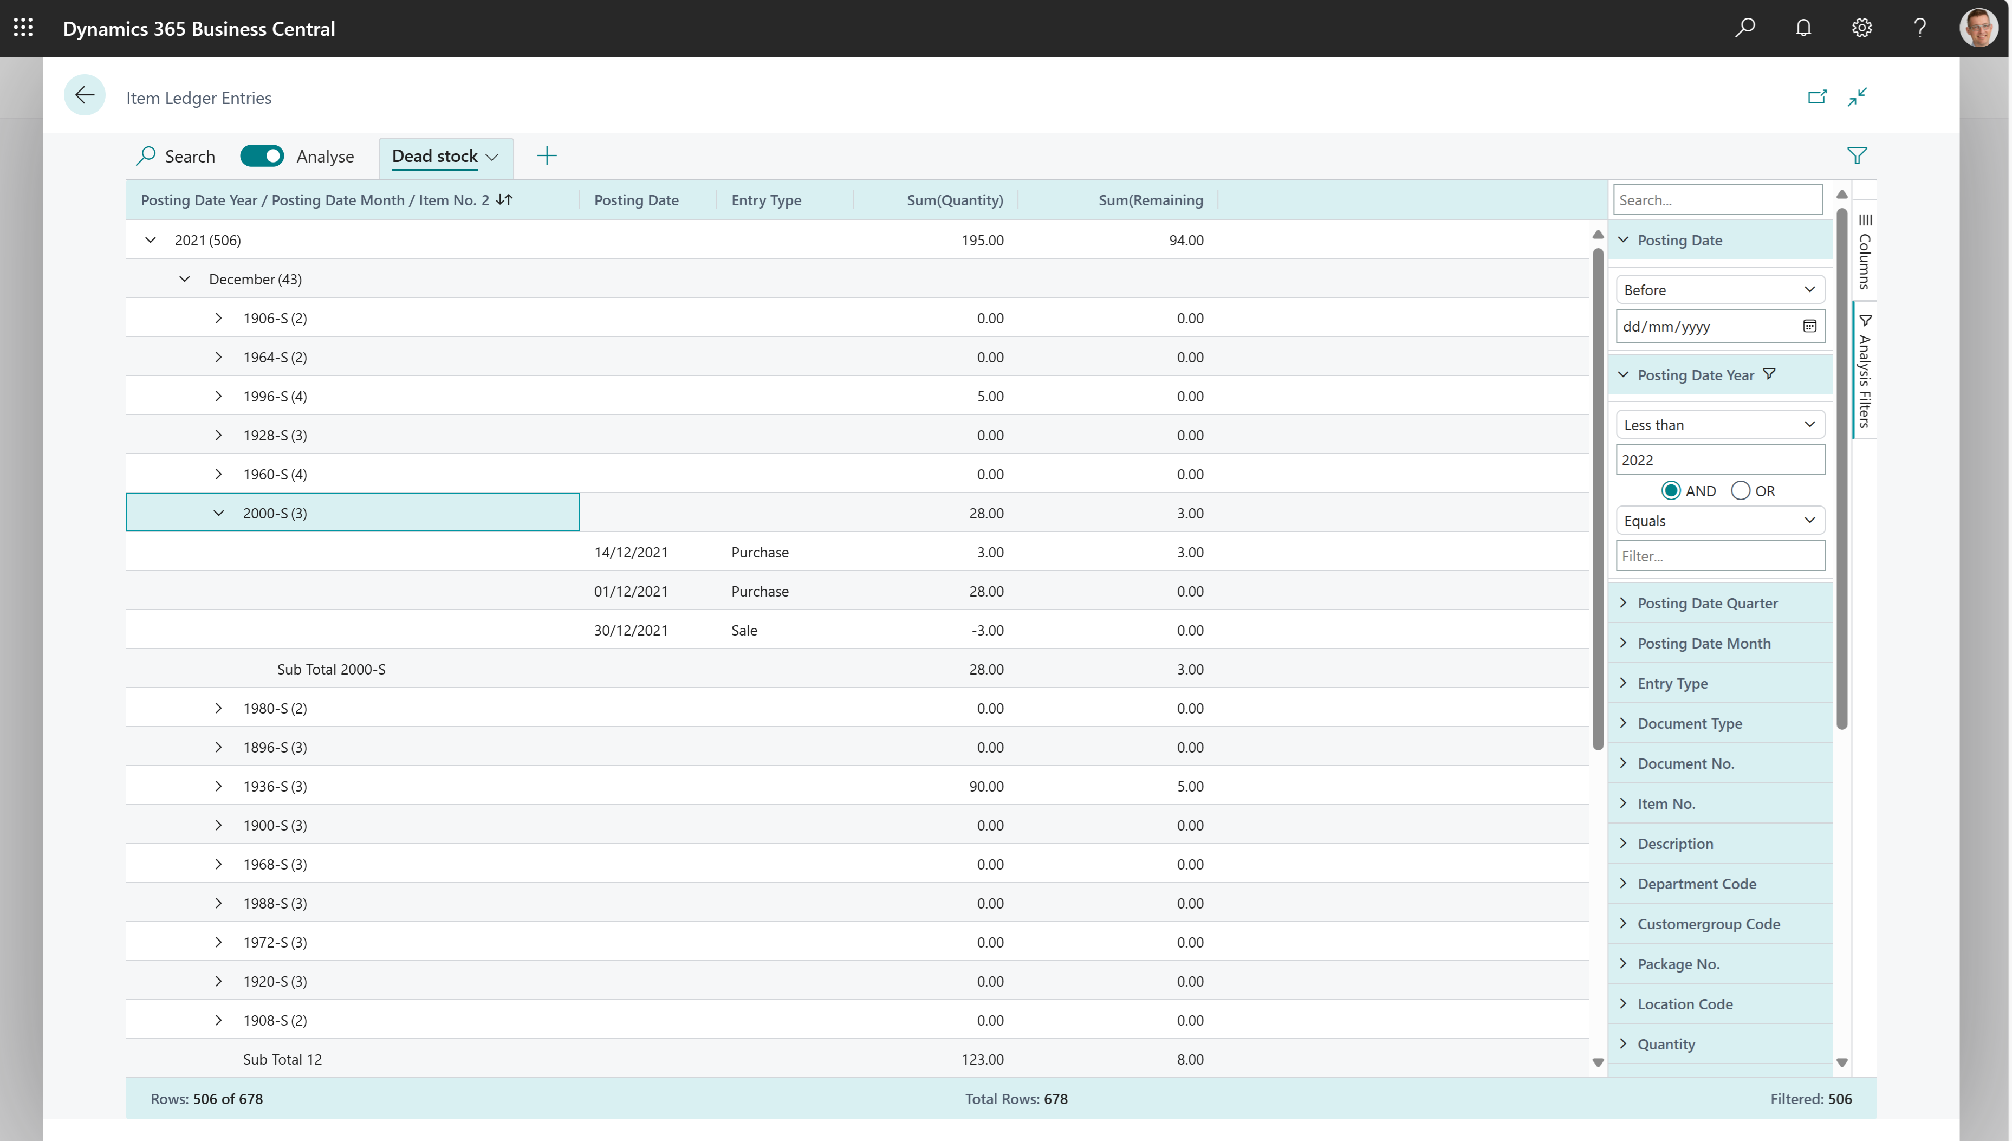
Notes:
Example: track expiring or old stock
See the recipe in the article Ad-hoc analysis of inventory data - Business Central | Microsoft Learn

Slide 48
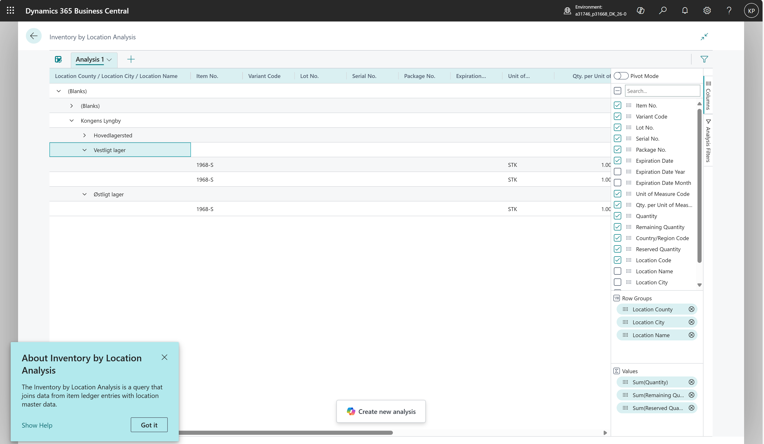
New in 26.1

Slide 49
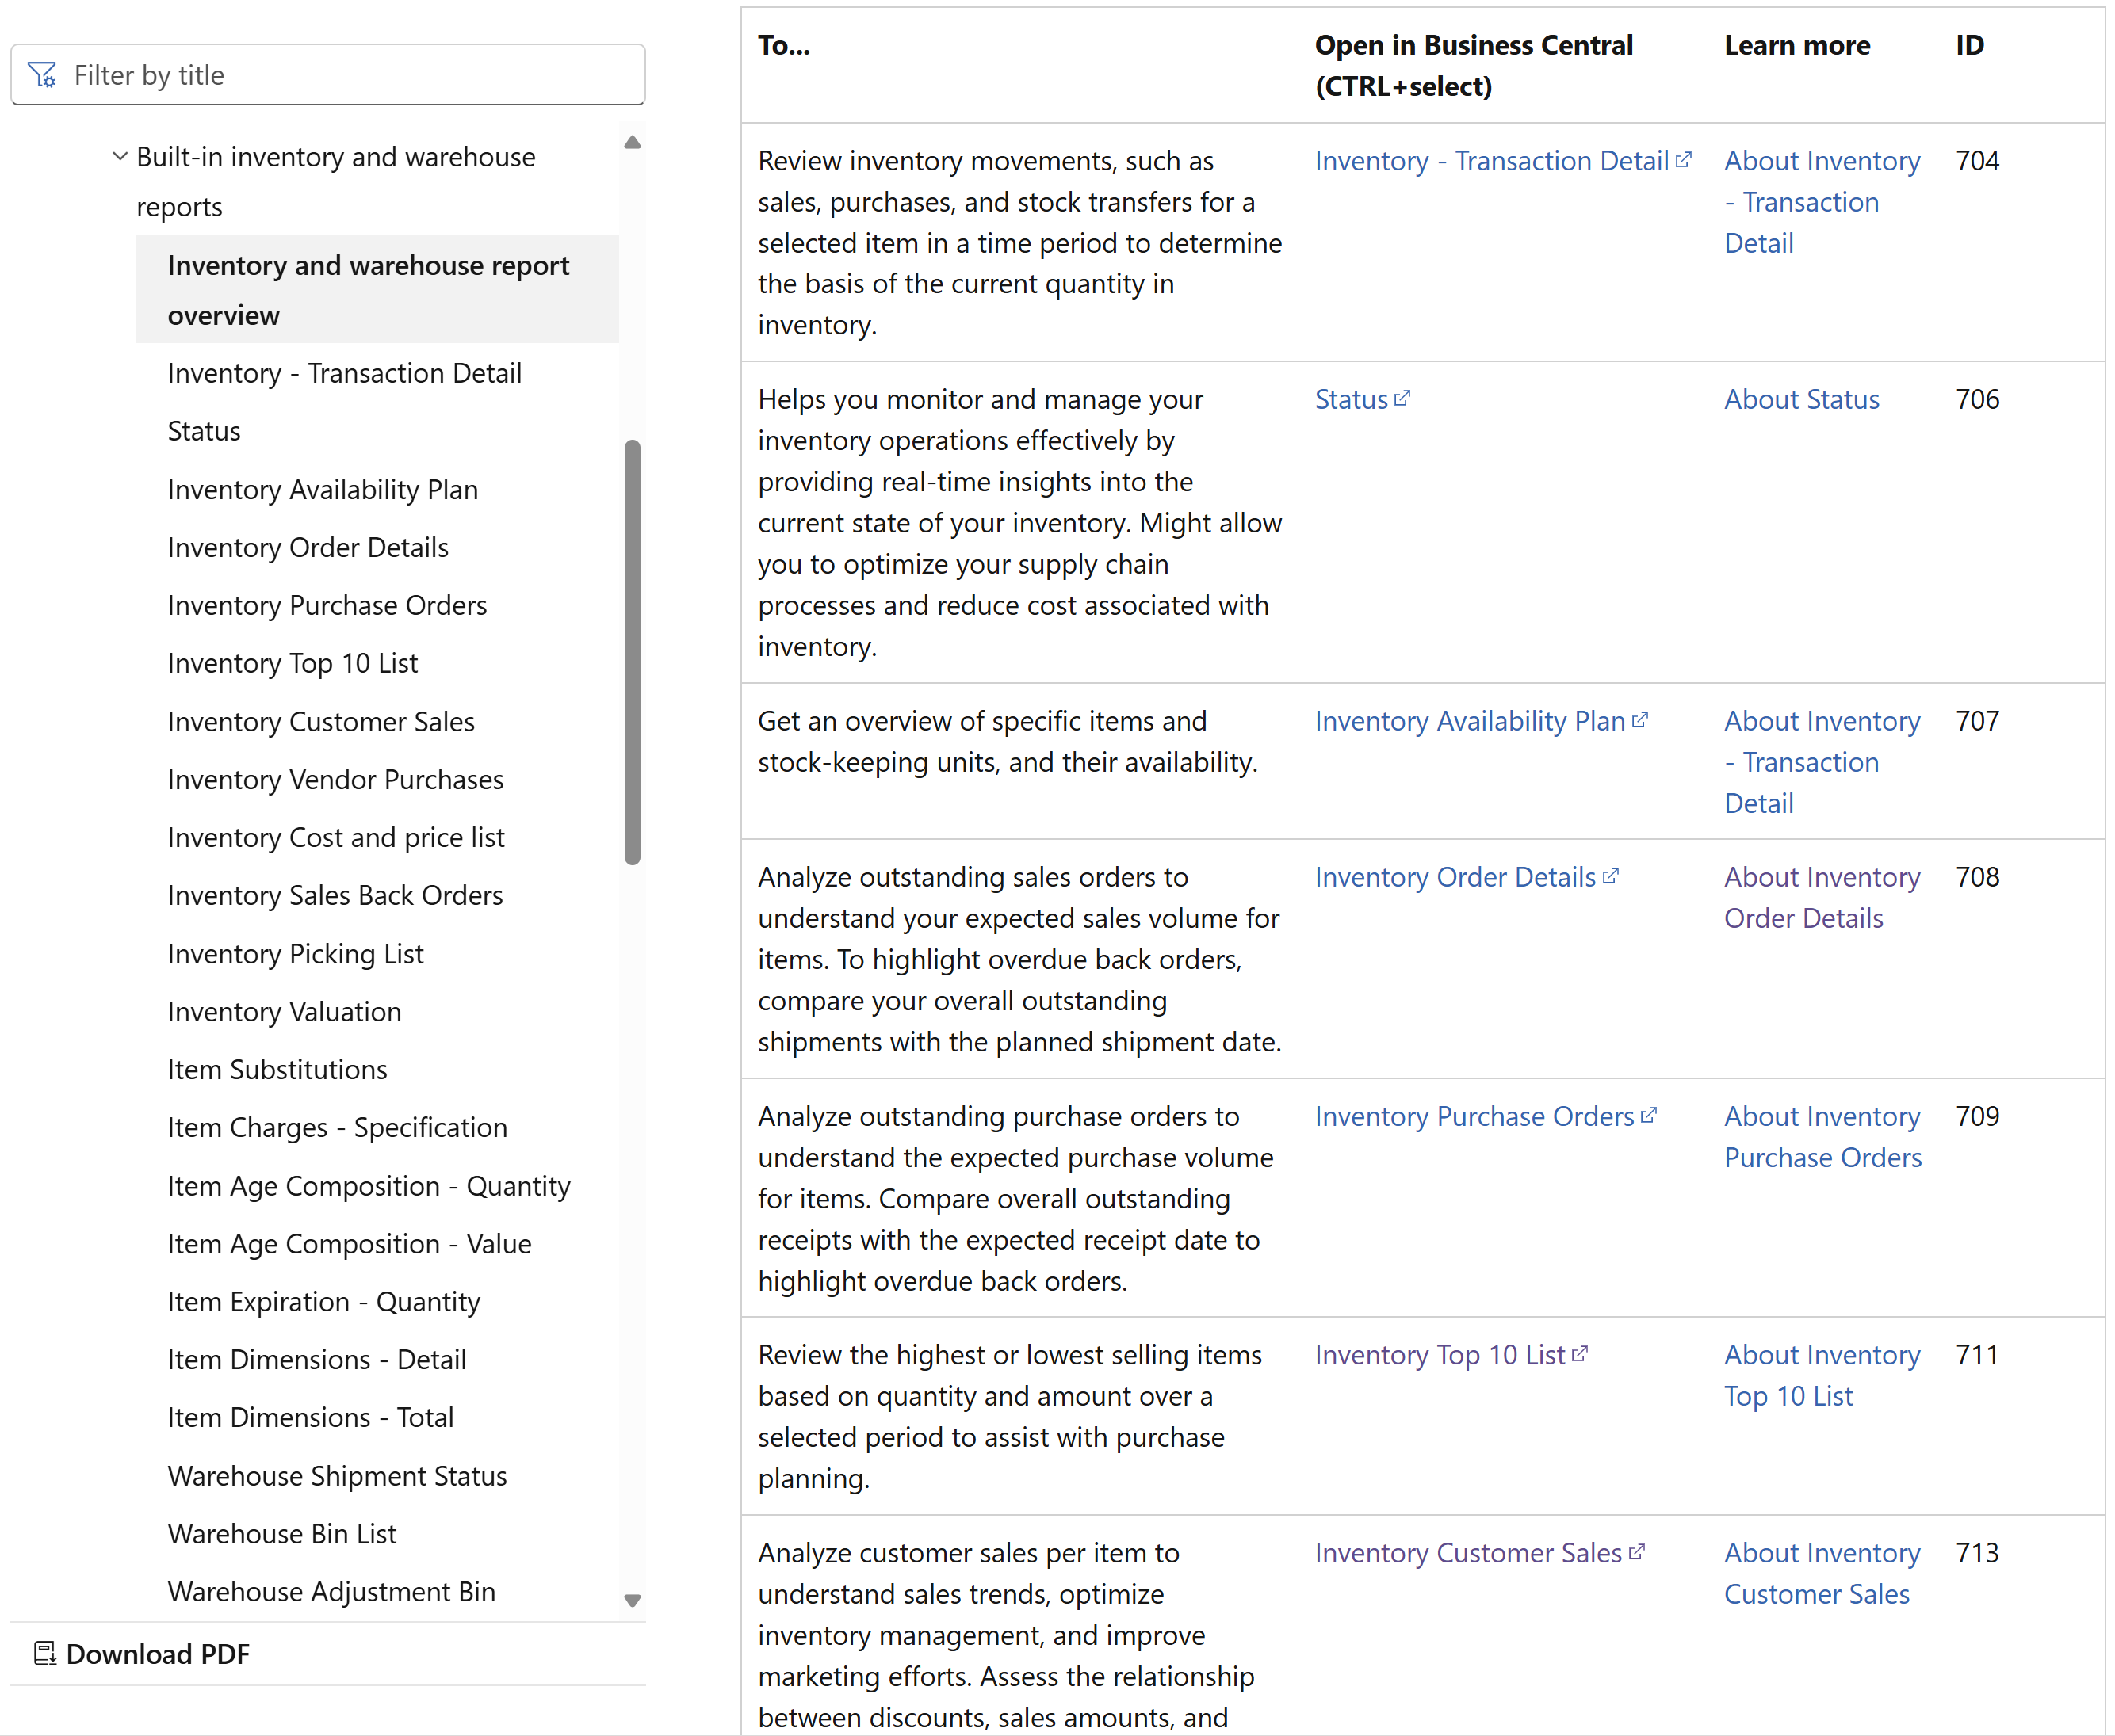
Inventory reports
Notes:
Go to the article
Inventory and warehouse reports and analytics - Business Central | Microsoft Learn
to learn more.

